Slide 1
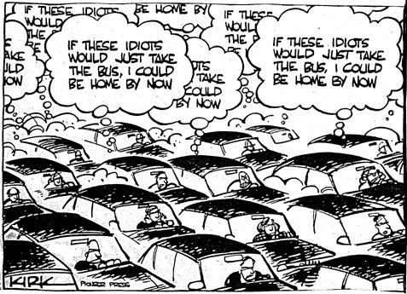
Distributed Algorithms on a Congested Clique
Christoph Lenzen

Slide 2
The LOCAL Model
1
3
7
16
42
compute
send
receive

Slide 3
The LOCAL Model
1
3
7
16
42
16
7
3
7
42
16
compute
send
receive

Slide 4
The LOCAL Model
1
3
7
16
42
16
7
3
7
42
16
compute
send
receive

Slide 5
The LOCAL Model
1
3
7
16
42
3,7
16,42
7,16
7
3,16
3,7
compute
send
receive

Slide 6
The LOCAL Model
1
3
7
16
42
3,7
16,42
7,16
7
3,16
3,7
compute
send
receive

Slide 7
The LOCAL Model
1
3
7
16
42
compute
send
receive

Slide 8
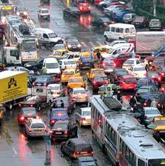
restricted
bandwidth
LOCAL
+
=
CONGEST
!
+
=
?
synchr. rounds:
compute
send
receive
message size:
O(log n) bits
round
complexity?
...content can differ
between neighbors!

Slide 9
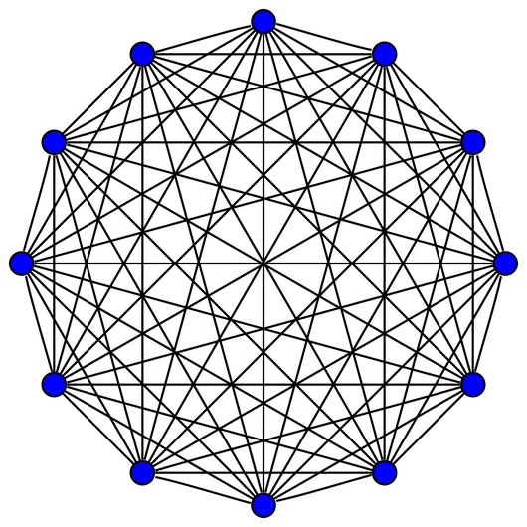
What happens here?

Slide 10
Disclaimer
Algorithms for overlay networks?
Subroutines for small cliques in larger networks?
So why should we care?!?
Practical relevance
of this model
is questionable!

Slide 11
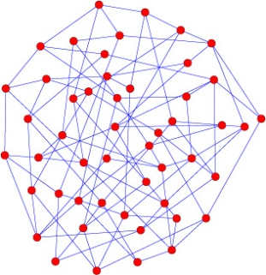
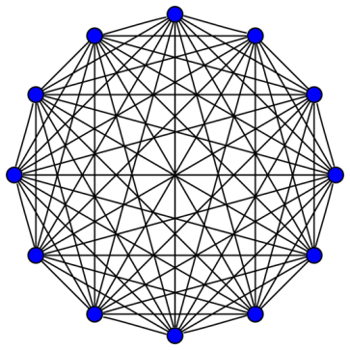
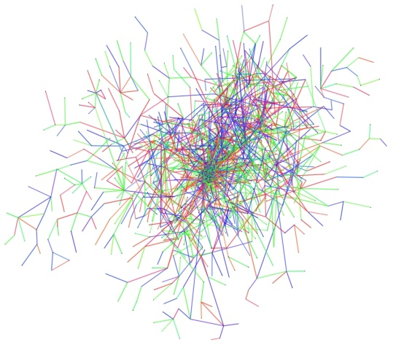
what lower bound graphs look like:
what “real”
networks look like:

Slide 12
History: MST Lower Bound
Peleg and Rubinovich
SIAM J. on Comp.‘00
Input: weighted graph
Output: spanning tree
Goal: minimize weight of tree
0
0
?
1
?
0
1
?
0
1
Alice
?
.
.
.
1
Bob
0
≈ √n x √n

Slide 13
History: MST Lower Bound
Peleg and Rubinovich
SIAM J. on Comp.‘00
Input: weighted graph
Output: spanning tree
Goal: minimize weight of tree
- Alice gets bit string b as input
0
0
?
1
?
0
1
?
0
1
Alice
?
.
.
.
1
Bob
0

Slide 14
History: MST Lower Bound
Peleg and Rubinovich
SIAM J. on Comp.‘00
Input: weighted graph
Output: spanning tree
Goal: minimize weight of tree
- Alice gets bit string b as input
- assign weight 2b_{i} to i^{th} edge
0
0
2
1
0
0
1
0
0
1
Alice
2
.
.
.
1
Bob
0

Slide 15
History: MST Lower Bound
Peleg and Rubinovich
SIAM J. on Comp.‘00
Input: weighted graph
Output: spanning tree
Goal: minimize weight of tree
- Alice gets bit string b as input
- assign weight 2b_{i} to i^{th} edge
- compute MST
=> Bob now knows b!
=> Alice sent ≥|b| bits to Bob
How long does this take?
0
0
2
1
0
0
1
0
0
1
Alice
2
.
.
.
1
Bob
0

Slide 16
History: MST Lower Bound
Peleg and Rubinovich
SIAM J. on Comp.‘00
Input: weighted graph
Output: spanning tree
Goal: minimize weight of tree
|b| bits sent in time T log n
=> |b|/T edge-disjoint paths
T ≤ o(√n)
=> paths use tree edges
to “shortcut” Ω(√n) hops
≈ √n x √n

Slide 17
History: MST Lower Bound
Peleg and Rubinovich
SIAM J. on Comp.‘00
Input: weighted graph
Output: spanning tree
Goal: minimize weight of tree
for each path p:
- p_{i} subpaths in tree
- h(p_{i}) max. dist. from leaves
- ∑_{i} 2^{h(pi)} ≥ Ω(√n)
but ∑_{p} ∑_{i} 2^{h(pi)} ≤ √n log n
=> O(log n) paths, T ≥ Ω(√n/log² n)
h(p_{i})=2
h(p_{i})=1

Slide 18
MST Lower Bound: Summary
- general technique
- yields lower bounds of roughly Ω(√n)
- helped finding many near-matching algorithms
Das Sarma et al.
STOC`11
Das Sarma et al.
SPAA`12
L. and Peleg
PODC`12
Peleg et al
ICALP`12
Elkin
ACM Trans. on Alg.`05
Elkin
SIAM J. on Comp.`06
Elkin and Peleg
SIAM J. on Comp.`04
Frischknecht et al.
SODA`12
Khan et al.
Dist. Computing`12
Khan and Pandurangan
Dist. Computing`08
Kutten and Peleg
J. Algorithms`98
L. and Patt-Shamir
STOC`13
Holzer and Wattenhofer
PODC`12

Slide 19
But How About Well-Connected Graphs?
diameter | upper bound | lower bound
O(log n) | O(n^{1/2} log* n) | Ω(n^{1/2}/log² n)
4 | ? | Ω(n^{1/3}/log n)
3 | ? | Ω(n^{1/4}/log n)
2 | O(log n) | ?
1 | O(log log n) | ?
Lotker et al.
Dist. Computing´06
Lotker et al.
SIAM J. on Comp.`05

Slide 20
But How About Well-Connected Graphs?
diameter | upper bound | lower bound
O(log n) | O(n^{1/2} log* n) | Ω(n^{1/2}/log² n)
4 | ? | Ω(n^{1/3}/log n)
3 | ? | Ω(n^{1/4}/log n)
2 | O(log n) | ?
1 | O(log log n) | ?
All known lower bounds
are based on hardness of
spreading information!

Slide 21
What happens here?

Slide 22
What happens here?
...multi-party
communication
complexity!
What happens if there is no
communication bottleneck?

Slide 23
What We Know: MST
input: weight of adjacent edges
output: least-weight spanning tree
O(log log n) rounds
no non-trivial lower bound known
5
1
5
5
3
3
∞
Lotker et al.,
Distr. Comp.‘06
∞
∞
1

Slide 24
What We Know: Triangle Detection
input: adjacent edges in input graph
output: whether input contains triangle
O(n^{1/3}/log n) rounds
no non-trivial lower bound known
Dolev et al.
DISC‘12

Slide 25
What We Know: Metric Facility Location
input: costs for nodes & edges (metric)
output: nodes & edges s.t. selected nodes cover all
goal: mininimize cost
O(log log n log* n) rounds for O(1)-approx.
no non-trivial lower bound known
3
5
3
1
2
5
3
3
∞
Berns et al.,
ICALP‘12
5
∞
3
∞
1
∞

Slide 26
What We Know: Sorting
input: n keys/node
output: indices of keys in global order
O(1) rounds
trivially optimal
...
5, 20, 22, 42, 99
...
2., 5., 6., 15., 25.
...
...
...
...
PODC‘13
...
...

Slide 27
What We Know: Routing
input: n mess./node, each node dest. of n mess.
goal: deliver all messages
O(1) rounds
trivially optimal
PODC‘13

Slide 28
Routing: Known Source/Destination Pairs
input: n messages/node (each to receive n mess.)
source/destination pairs common knowledge
“sources”
“destinations”
2 rounds

Slide 29
Routing within Subsets (Known Pairs)
{
√n
{
send/receive
n messages
within subsets
√n
{
√n

Slide 30
Routing within Subsets (Unknown Pairs)
Within each subset:
1. Broadcast #mess. for each destination 2 rounds
2. Compute communication pattern local comp.
3. Move messages 2 rounds
{
{
√n
√n
{
{
√n
√n
{
{
√n
√n

Slide 31
Routing: Known Source/Destination Sets
1. Compute pattern on set level local comp.
2. Redistribute messages within sets 4 rounds
3. Move messages between sets 1 round
4. Redistribute messages within sets 4 rounds
5. Move messages between sets 1 round
6. Deliver messages within sets 4 rounds
- n^{1/2} supernodes
- degree n^{3/2}
n mess. between
each pair
- n links between sets
- each pair can
handle n mess.

Slide 32
Routing: Unknown Pairs
source/destination pairs
only relevant w.r.t. sets
count within sets (one node/dest.) 1 round
broadcast information to all nodes 1 round

Slide 33
Routing: Result
Theorem
Input:
up to n messages at each node
each node destination of up to n messages
Then:
all messages can be delivered in 16 rounds

Slide 34
...or in Other Words:
fully connected
CONGEST
≈
bulk-synchronous
(bandwidth n log n)
in each round, each node
computes
sends up to n log n bits
receives up to n log n bits

Slide 35
What Do We Want in a Lower Bound?
- caused by “lack of coordination”, not bottleneck
→ input per node of size O(n log n)
ideally, also:
- “natural” problem
- strong bound (e.g. Ω(n^{c}) for constant c>0)
- unrestricted algorithms

Slide 36
Triangle Detection: an Algorithm
input: adjacent edges in input graph
output: whether input contains triangle

Slide 37
Triangle Detection: an Algorithm
- partition nodes into subsets of n^{2/3} nodes
- consider all n triplets of such subsets
- assign triplets 1:1 to nodes
- responsible node checks for triangle in its triplet
→ needs to learn of n^{4/3} (pre-determined) edges
→ running time O(n^{1/3}/log n)
subset 1 2 3 4 5 6
detected by node
with triplet (3,2,4)

Slide 38
Triangle Detection: an Algorithm
“oblivious” algorithm:
- fixed message pattern
- computation only initially and in the end
…and maybe even in general?
Conjecture
running time O(n^{1/3}/log n)
optimal for oblivious algorithms

Slide 39
MST and Friends
some doubly logarithmic bounds:
- MST in O(log log n) rounds
- Metric Facility Location in O(log log n log* n) rounds
- no improvement or lower bound on MST for a decade
Open Question
Is running time O(log log n)
a barrier for some problems?

Slide 40
Connectivity
input: adjacent edges in input graph
output: whether input graph is connected
- natural problem, even simpler than MST
- might be easier to find right approach
Open Question
Can Connectivity be decided
within O(1) rounds?

Slide 41
...on a Related Subject
There is a lower bound, on Set Disjointness!
(but in a different model)
...thank you for your attention!
→ Don‘t miss the next talk!

