Slide 1
Lower Bounds on the Communication of Distributed Graph Algorithms:
Progress and Obstacles
Rotem Oshman
ADGA 2013

Slide 2
Overview: Network Models
LOCAL
CONGESTED CLIQUE
CONGEST / general network
ASYNC MESSAGE-PASSING
X

Slide 3
Talk Overview
Lower bound techniques
  CONGEST general networks: reductions from 2-party communication complexity
  Asynchronous message passing: reductions from multi-party communication complexity
Obstacles on proving lower bounds for the congested clique

Slide 4


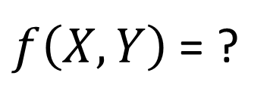


Communication Complexity
$f\left(X,Y\right)$ = ?
$$X$$
$$Y$$

Slide 5
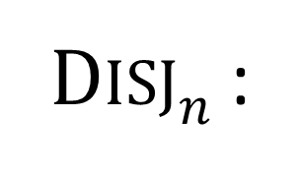
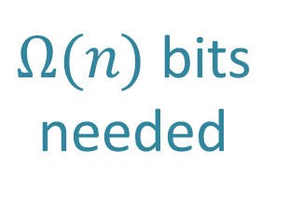



Example: Disjointness
Disj$n$ :
$$X∩Y=∅?$$
$Ω(n)$ bits
needed
$$X⊆\{1,…,n\}$$
$$Y⊆\{1,…,n\}$$
[Kalyanasundaram and Schnitger, Razborov ’92]

Slide 6






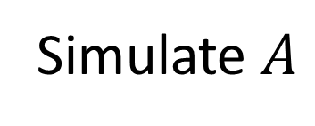



Applying 2-Party Communication Complexity Lower Bounds
Textbook reduction:
Given algorithm $A$ for solving task $T$…
$$X$$
$$Y$$
Simulate $A$
Based on $X$
Based on $Y$
$n$ bits
Solution for $T$ $⇨$ answer for Disjointness

Slide 7
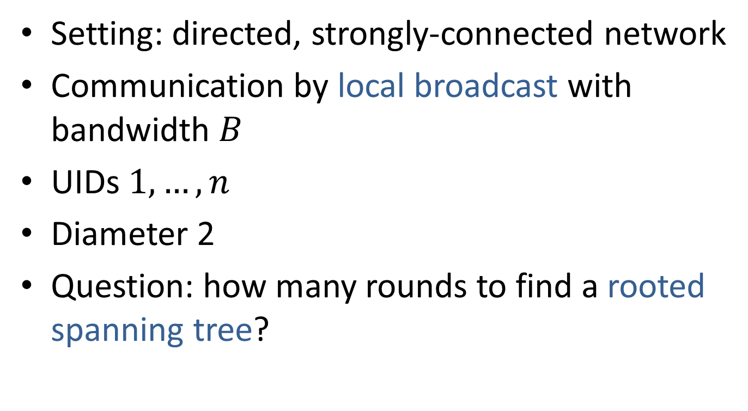
Example: Spanning Trees
Setting: directed, strongly-connected network
Communication by local broadcast with bandwidth $B$
UIDs $1,…,n$
Diameter 2
Question: how many rounds to find a rooted spanning tree?

Slide 8
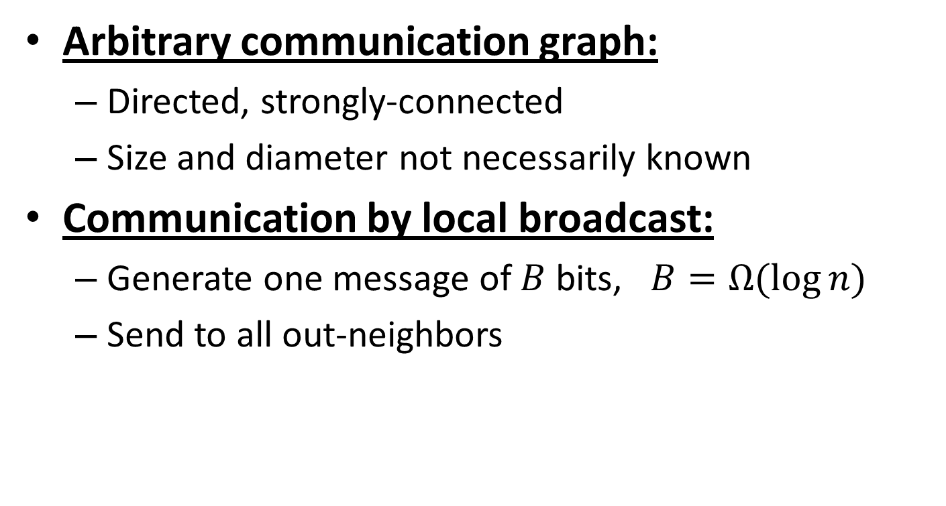
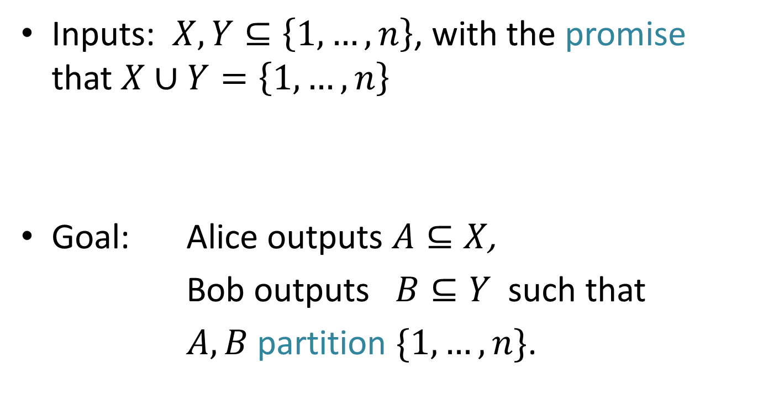

New Problem: Partition
Inputs: $X,Y⊆\left\{1,…,n\right\}$, with the promise that $X∪Y=\left\{1,…,n\right\}$
Goal: Alice outputs $A⊆X$,
Bob outputs $B⊆Y$ such that
$A,B$ partition $\{1,…,n\}$.
$$Y$$
$$X$$

Slide 9
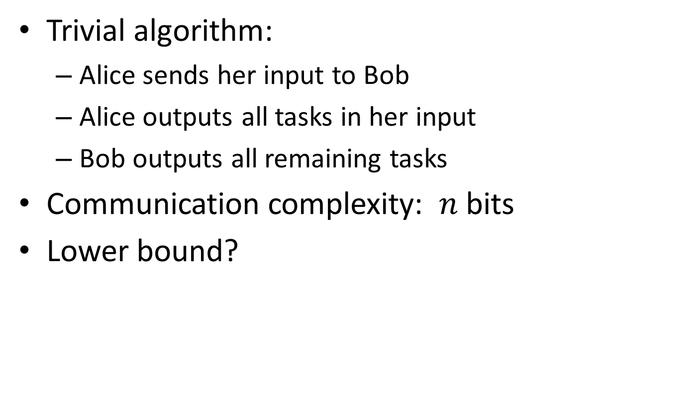
The Partition Problem
Trivial algorithm:
  Alice sends her input to Bob
  Alice outputs all tasks in her input
  Bob outputs all remaining tasks
Communication complexity: $n$ bits
Lower bound?

Slide 10
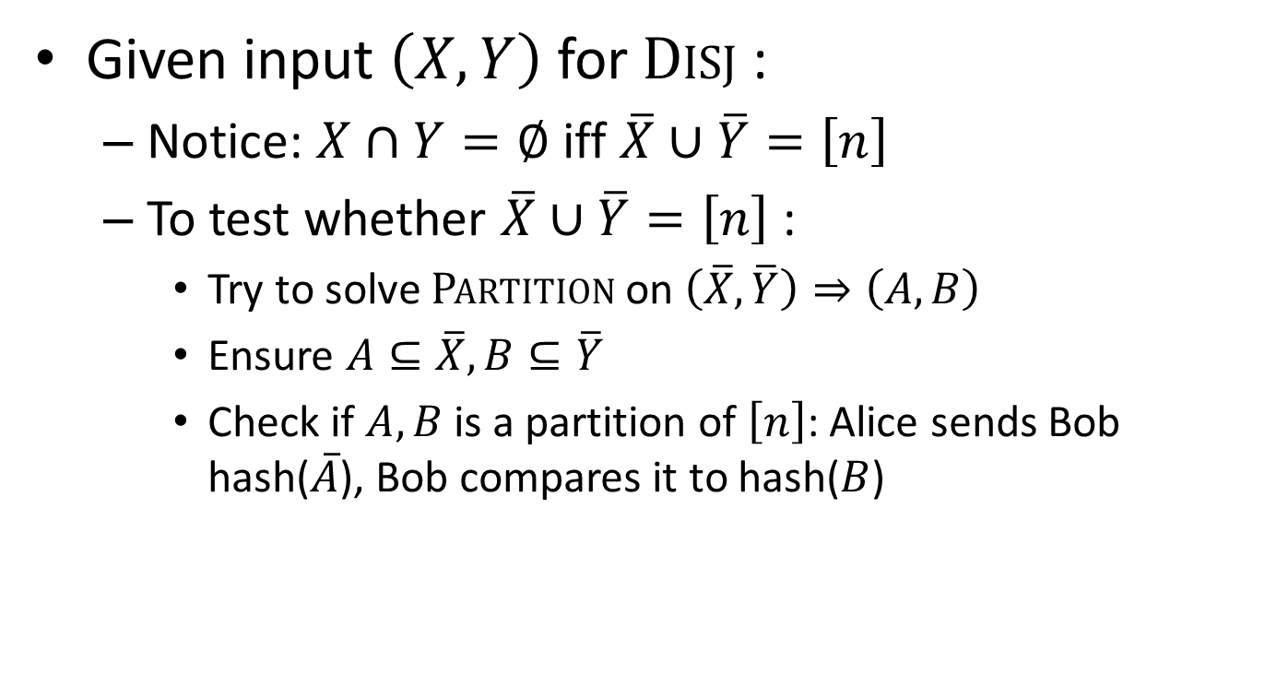
Reduction from Disj to Partition
Given input $\left(X,Y\right)$ for Disj :
  Notice: $X∩Y=∅$ iff $\overline{X}∪\overline{Y}=\left[n\right]$
  To test whether $\overline{X}∪\overline{Y}=\left[n\right]$:
    Try to solve Partition on $\left(\overline{X},\overline{Y}\right)⇒\left(A,B\right)$
    Ensure $A⊆\overline{X},B⊆\overline{Y}$
    Check if $A, B$ is a partition of $\left[n\right]$: Alice sends Bob hash($\overline{A}$), Bob compares it to hash($B$)

Slide 11




From Partition to Spanning Tree
Given a spanning tree algorithm $A$…
1
2
3
4
5
6
a
b
$$X=\{1,2,3\}$$
$$Y=\{2,4,5,6\}$$

Slide 12
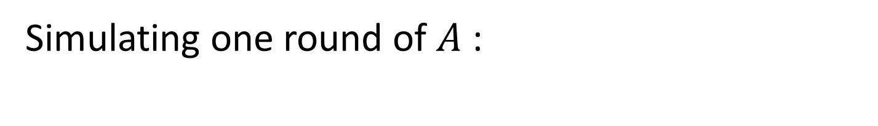
From Partition to Spanning Tree
Simulating one round of $A$ :
1
2
3
4
5
6
a
b
Node b’s message
Node a’s message
$$X=\{1,2,3\}$$
$$Y=\{2,4,5,6\}$$

Slide 13

From Partition to Spanning Tree
When $A$ outputs a spanning tree:
1
2
3
4
5
6
a
b
$$X=\{1,2,3\}$$
$$Y=\{2,4,5,6\}$$

Slide 14

From Partition to Spanning Tree
If $A$ runs for $t$ rounds, we use $2Bt$ bits
$⇒t=Ω\left(n/B\right)$
One detail: randomness
  Solution: Alice and Bob use public randomness

Slide 15
When Two Players Just Aren’t Enough
No bottlenecks in the network

Slide 16
When Two Players Just Aren’t Enough
Too much information revealed

Slide 17








Multi-Player Communication Complexity
Communication by shared blackboard
Number-on-forehead
Number-in-hand
??

Slide 18
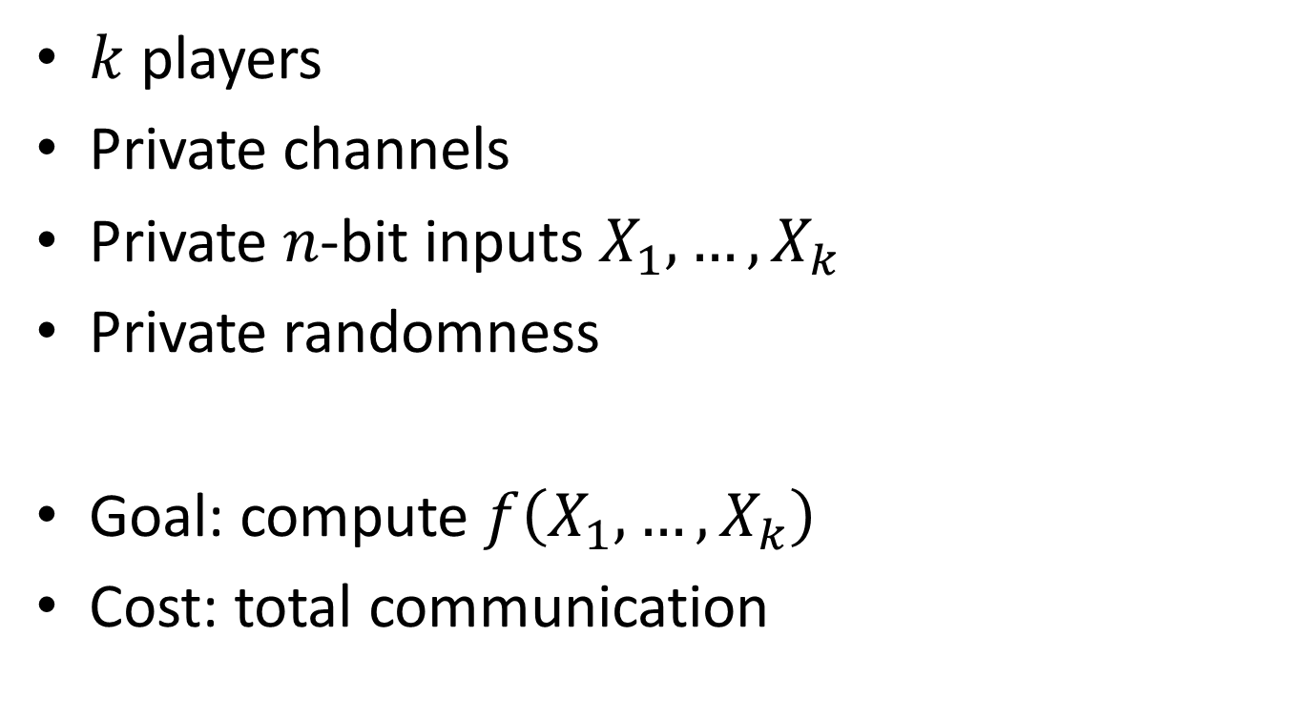
The Message-Passing Model
$k$ players
Private channels
Private $n$-bit inputs $X_{1},…,X_{k}$
Private randomness
Goal: compute $f\left(X_{1},…,X_{k}\right)$
Cost: total communication

Slide 19
The Coordinator Model
$k$ players, one coordinator
The coordinator has no input

Slide 20
Message-Passing vs. Coordinator
$$≈$$

Slide 21
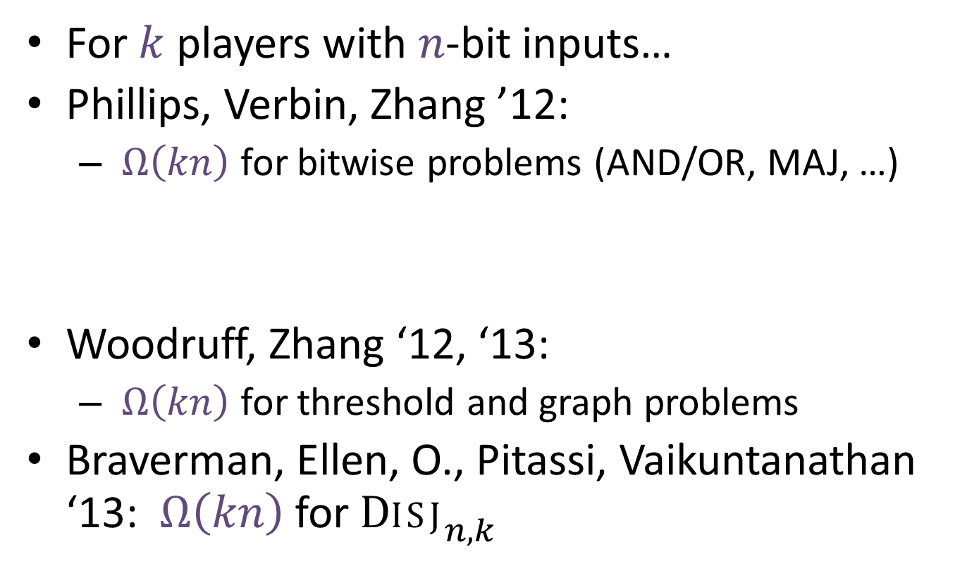
Prior Work on Message-Passing
For $k$ players with $n$-bit inputs…
Phillips, Verbin, Zhang ’12:
  $Ω\left(kn\right)$ for bitwise problems (AND/OR, MAJ, …)
Woodruff, Zhang ‘12, ‘13:
  $Ω\left(kn\right)$ for threshold and graph problems
Braverman, Ellen, O., Pitassi, Vaikuntanathan ‘13: $Ω\left(kn\right)$ for ${\text{Disj}}_{n,k}$

Slide 22
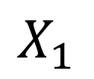
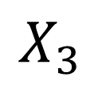
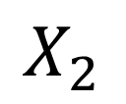
Set Disjointness
$$X_{2}$$
$$X_{1}$$
$$X_{3}$$
?
$$X_{5}$$
$$X_{4}$$
$${\text{Disj}}_{n,k} =\bigvee_{i=1}^{n}{\bigwedge_{j=1}^{k}{X_{i}^{j}}}$$

Slide 23
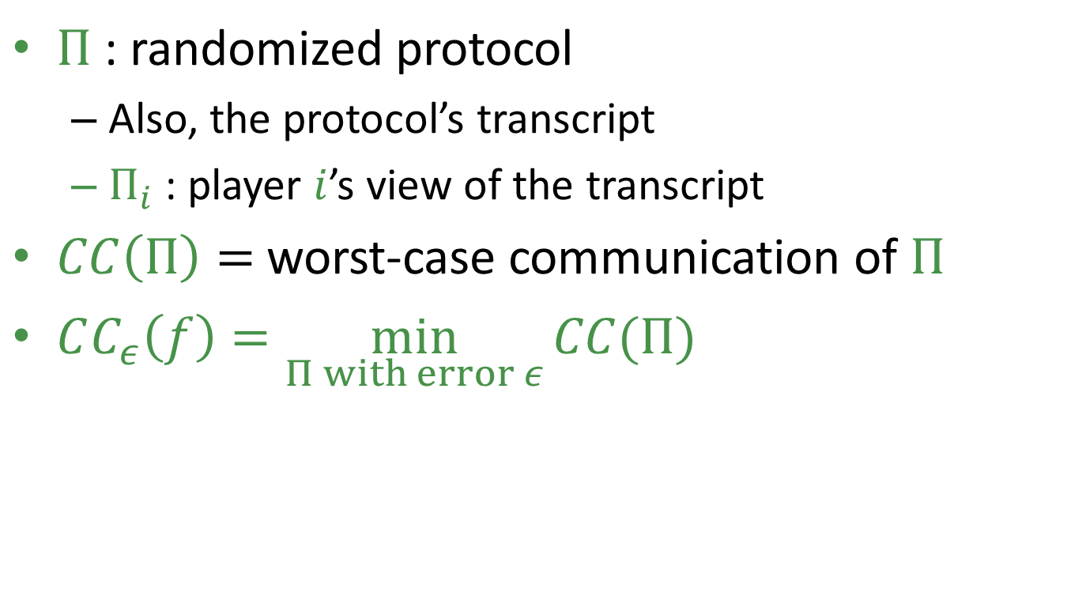
Notation
$Π$ : randomized protocol
  Also, the protocol’s transcript
  $Π_{i}$ : player $i$’s view of the transcript
$CC\left(Π\right)=$ worst-case communication of $Π$
$CC_{ε}\left(f\right)=\min_{Π with error ε}{CC(Π)}$
in the worst case

Slide 24
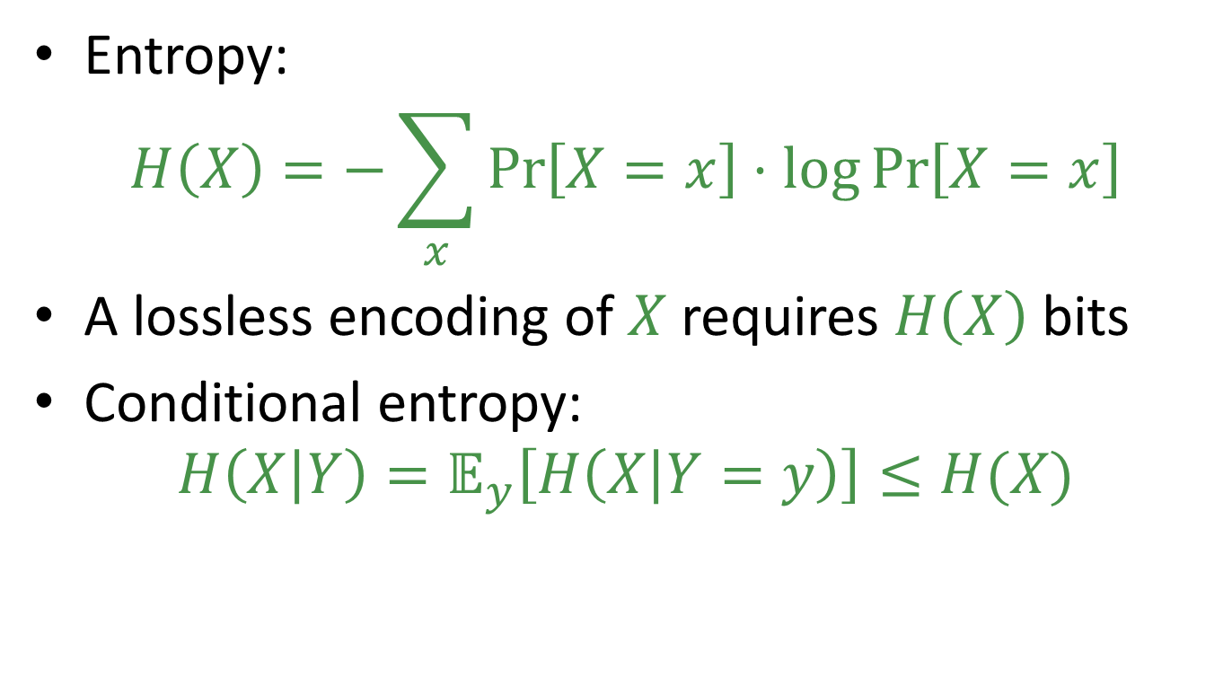
Entropy and Mutual Information
Entropy:
$$H\left(X\right)=−\sum_{x}{\operatorname{Pr}\left[X=x\right]⋅\log{\operatorname{Pr}\left[X=x\right]}}$$
A lossless encoding of $X$requires $H\left(X\right)$ bits
Conditional entropy:
$$H\left(X | Y\right)=𝔼_{y}\left[H\left(X | Y=y\right)\right]≤H(X)$$

Slide 25
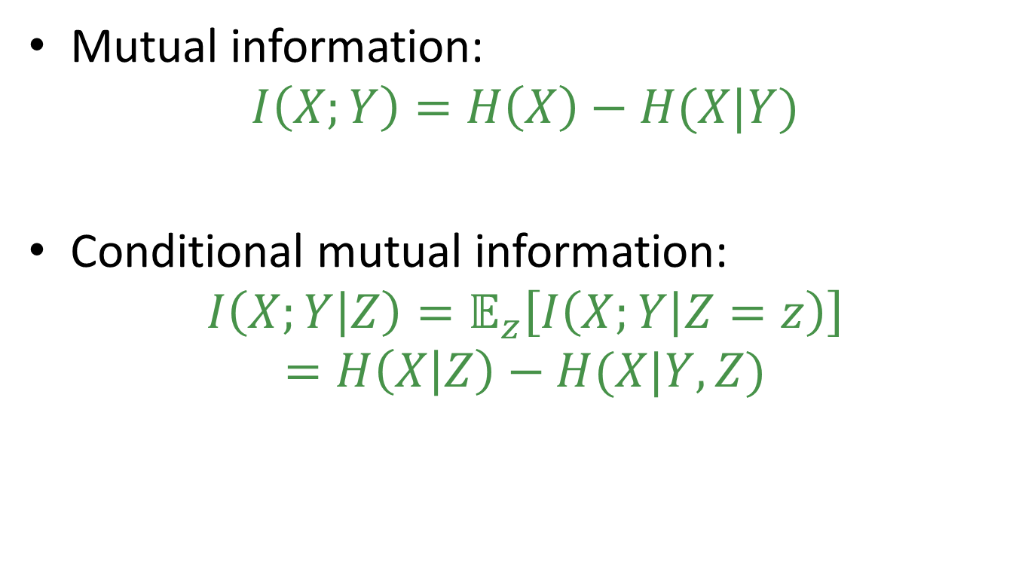
Entropy and Mutual Information
Mutual information:
$$I\left(X;Y\right)=H\left(X\right)−H(X|Y)$$
Conditional mutual information:
$$I\left(X;Y | Z\right)=𝔼_{z}\left[I\left(X;Y | Z=z\right)\right]=H\left(X | Z\right)−H(X|Y,Z)$$

Slide 26
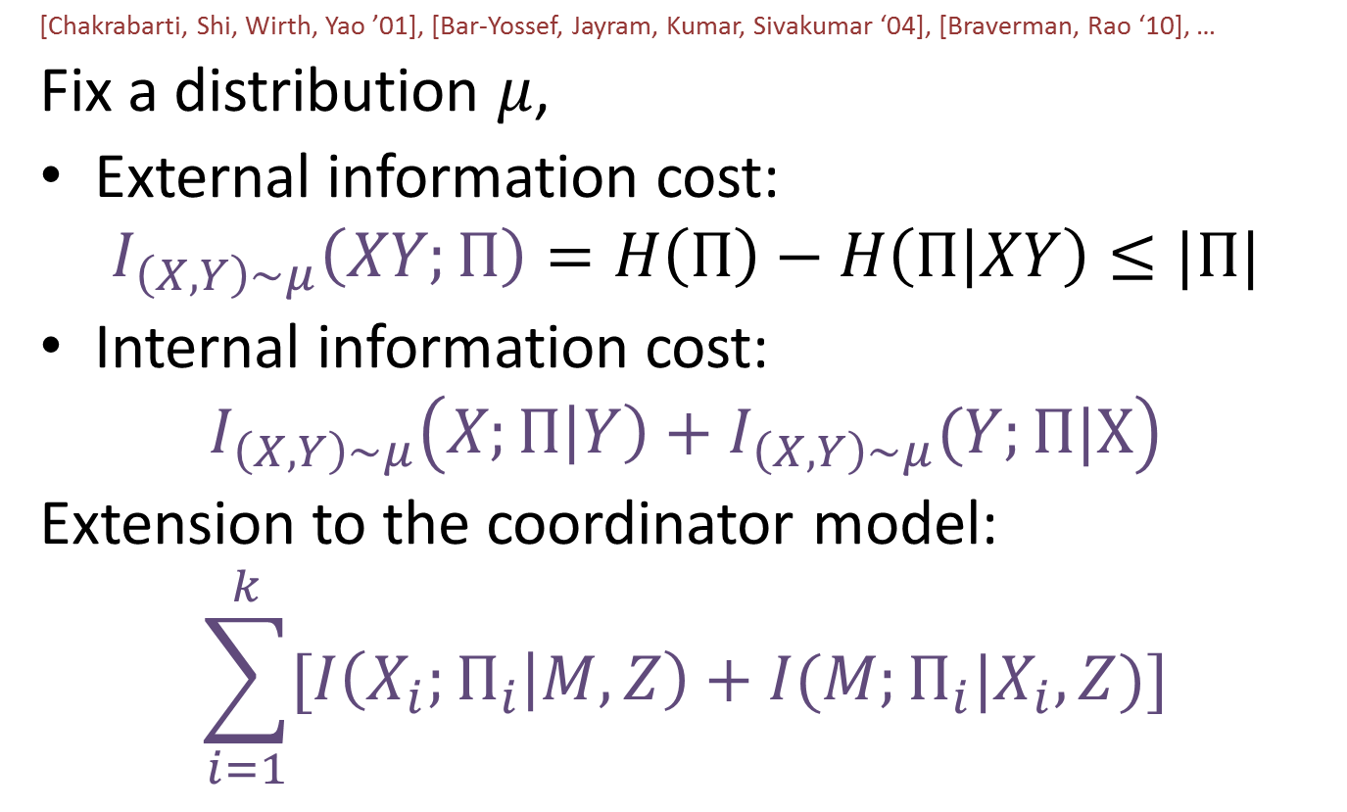
Information Cost for Two Players
[Chakrabarti, Shi, Wirth, Yao ’01], [Bar-Yossef, Jayram, Kumar, Sivakumar ‘04], [Braverman, Rao ‘10], …
Fix a distribution $μ$,
External information cost:
$$I_{\left(X,Y\right)∼μ}\left(XY;Π\right)=H\left(Π\right)−H\left(Π | XY\right)≤|Π|$$
Internal information cost:
$$I_{\left(X,Y\right)∼μ}\left(X;Π\left|Y\right)+I_{\left(X,Y\right)∼μ}(Y;Π|X\right)$$
Extension to the coordinator model:
$$\sum_{i=1}^{k}{[I\left(X_{i};Π_{i} | M,Z\right)+I(M;Π_{i}|X_{i},Z)]}$$

Slide 27
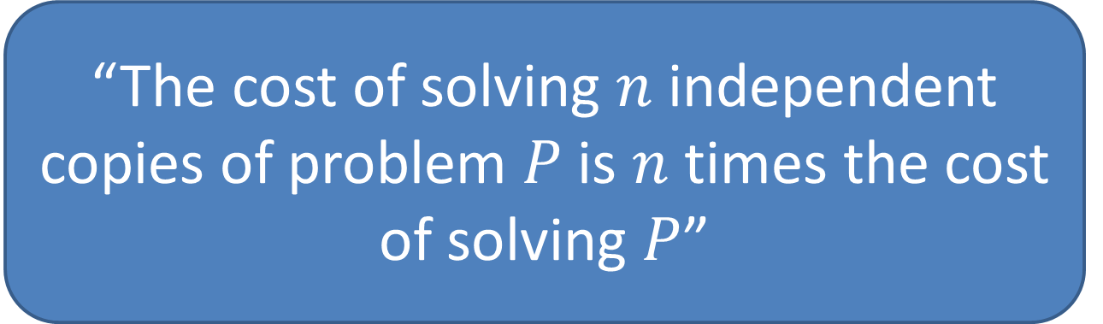
Why is Info Complexity Nice?
Formalizes a natural notion
  Analogous to causality/knowledge
Admits direct sum theorem:
“The cost of solving $n$ independent copies of problem $P$ is $n$ times the cost of solving $P$”

Slide 28

Example
$${\text{Disj}}_{n,k} =\bigvee_{i=1}^{n}{\bigwedge_{j=1}^{k}{X_{i}^{j}}}$$

Slide 29

Example (Work in Progress)
Triangle detection in general congested graphs
“Is there a triangle” =
$\bigvee_{\left\{v_{1},v_{2},v_{3}\right\}}{ }$”is ${\{v}_{1},v_{2},v_{3}\}$ a triangle”

Slide 30
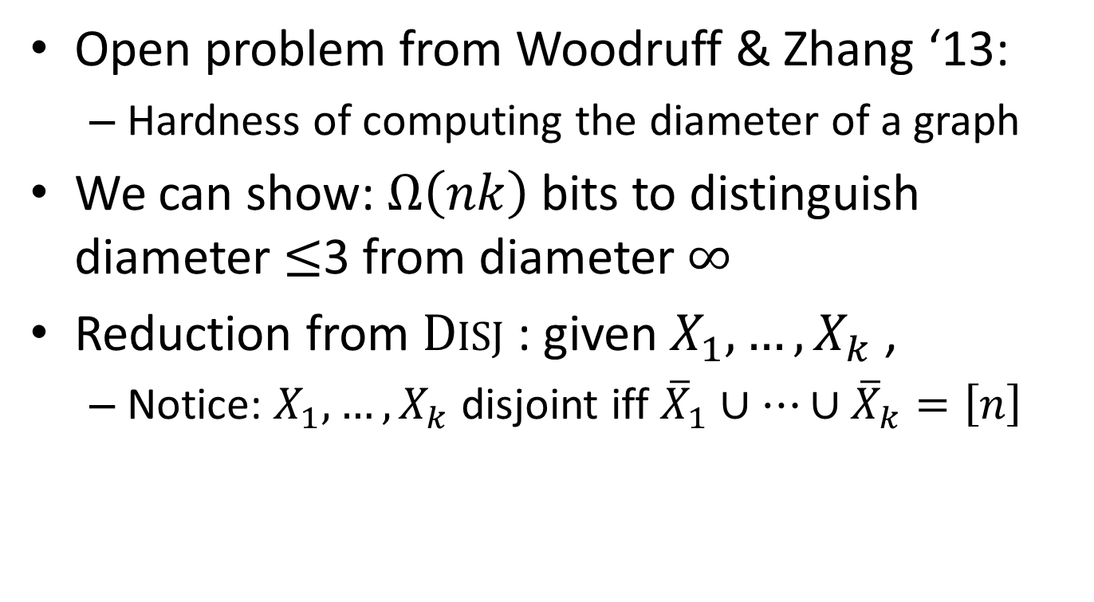
Application of Disj Lower Bound
Open problem from Woodruff & Zhang ‘13:
  Hardness of computing the diameter of a graph
We can show: $Ω\left(nk\right)$ bits to distinguish diameter $≤$3 from diameter $∞$
Reduction from Disj : given $X_{1},…,X_{k}$ ,
  Notice: $X_{1},…,X_{k}$ disjoint iff ${\overline{X}}_{1}∪…∪{\overline{X}}_{k}=\left[n\right]$

Slide 31












Application of Disj Lower Bound
${\overline{X}}_{1}∪…∪{\overline{X}}_{k}=\left[n\right]⇒$Diameter $≤3$
${\overline{X}}_{1}∪…∪{\overline{X}}_{k}≠\left[n\right]⇒$ Diameter $=∞$
$$3$$
$$2$$
$$4$$
$$p_{2}$$
$$1$$
$${\overline{X}}_{3}$$
$$5$$
$$p_{1}$$
$$p_{3}$$
$$p_{4}$$
$$6$$

Slide 32
Part II: The Power of the Congested Clique
CONGESTED CLIQUE

Slide 33
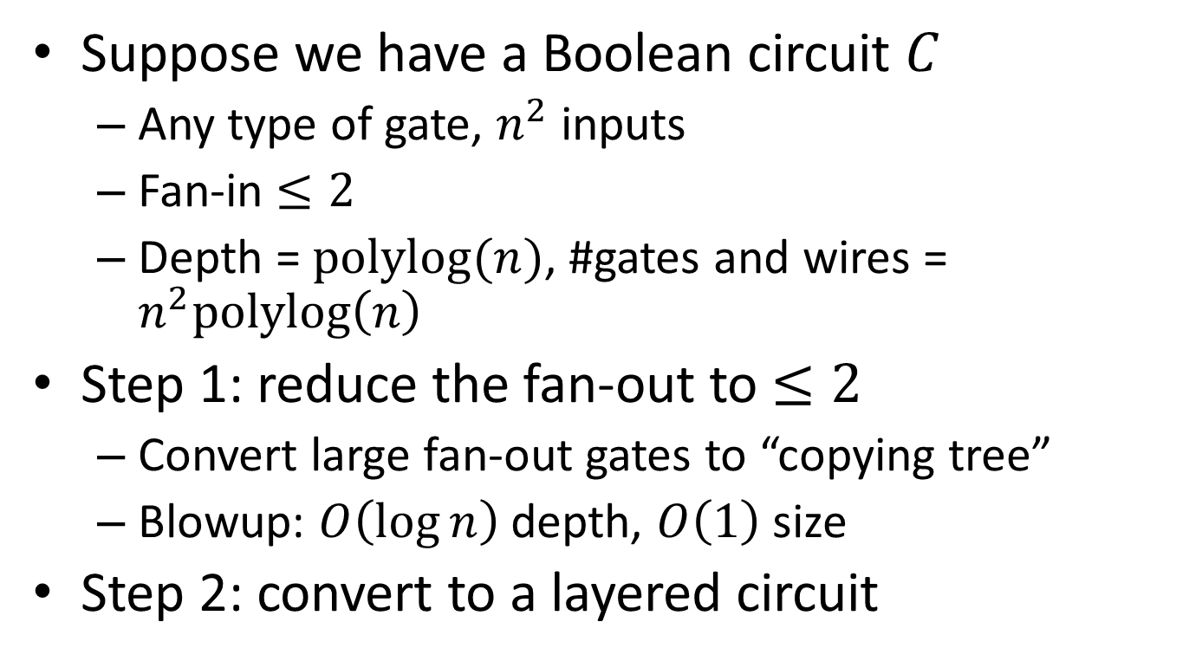
Conversion from Boolean Circuit
Suppose we have a Boolean circuit $C$
  Any type of gate, $n^{2}$ inputs
  Fan-in $≤2$
  Depth = $polylog(n)$, #gates and wires = $n^{2}polylog\left(n\right)$
Step 1: reduce the fan-out to $≤2$
  Convert large fan-out gates to “copying tree”
  Blowup: $O\left(\log{n}\right)$ depth, $O\left(1\right)$ size
Step 2: convert to a layered circuit

Slide 34
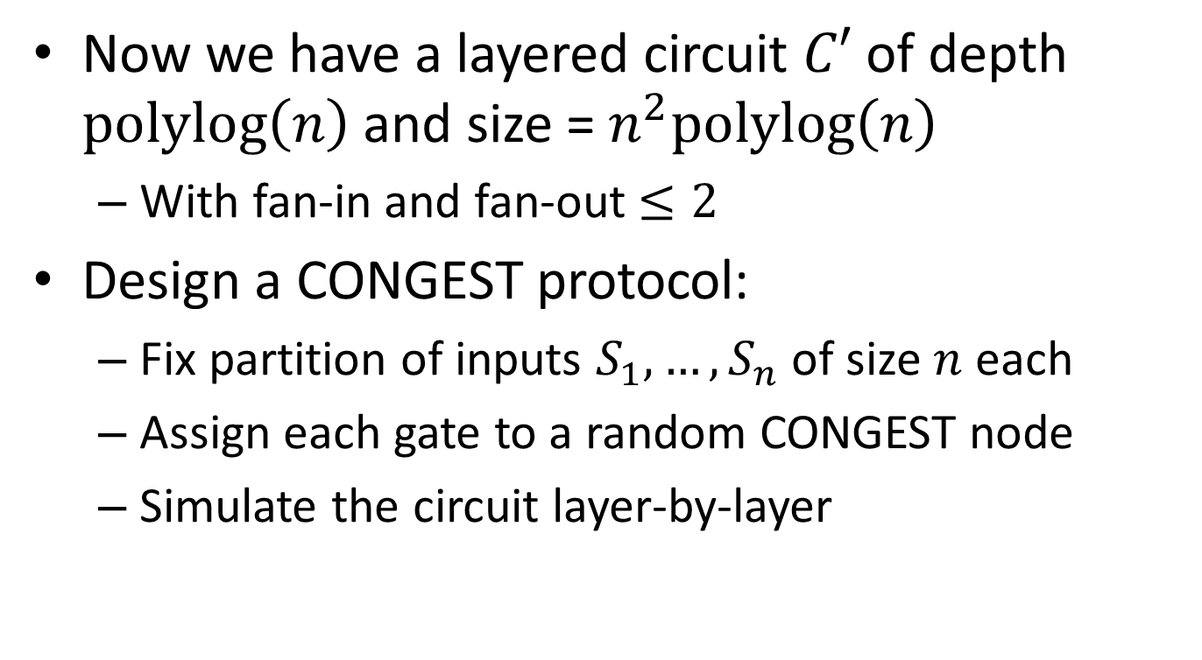
Conversion from Boolean Circuit
Now we have a layered circuit $C′$ of depth $polylog\left(n\right)$ and size = $n^{2}polylog\left(n\right)$
  With fan-in and fan-out $≤2$
Design a CONGEST protocol:
  Fix partition of inputs $S_{1},…,S_{n}$ of size $n$ each
  Assign each gate to a random CONGEST node
  Simulate the circuit layer-by-layer

Slide 35
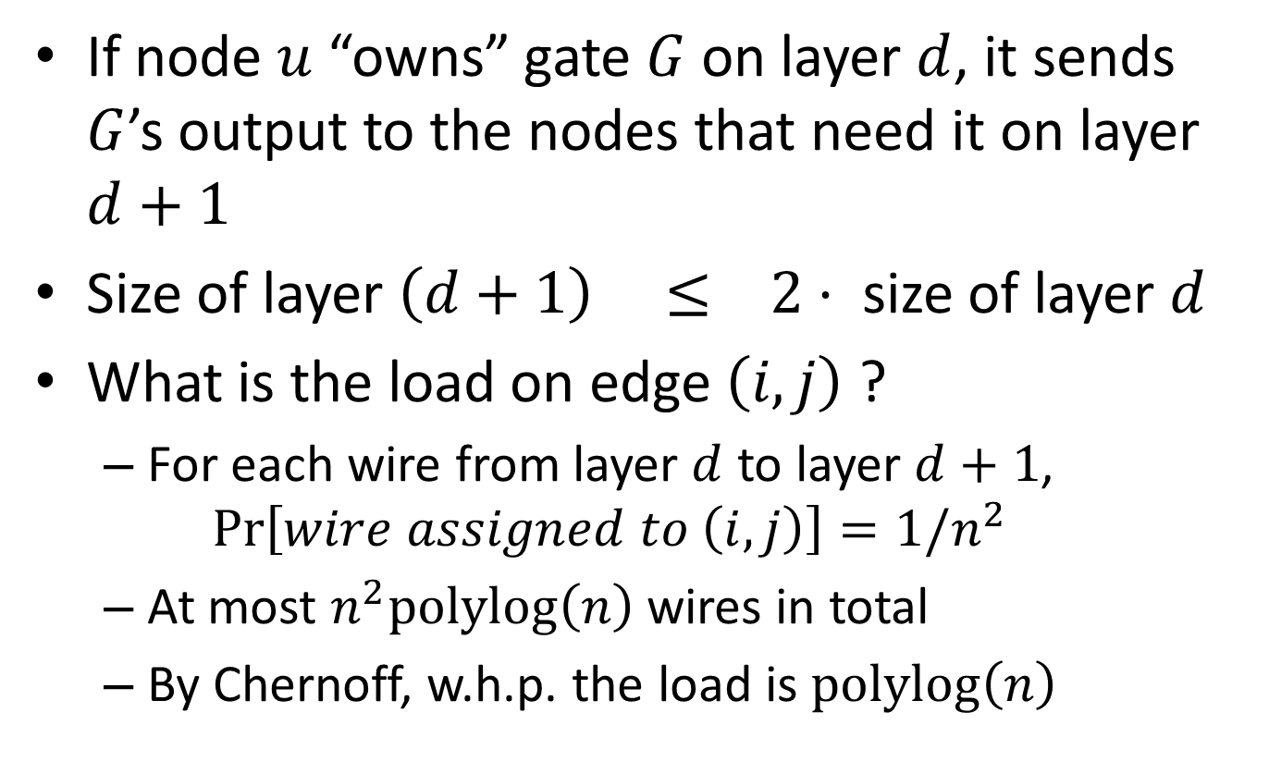
Simulating a Layer
If node $u$ “owns” gate $G$ on layer $d$, it sends $G$’s output to the nodes that need it on layer $d+1$
Size of layer $\left(d+1\right) ≤ 2⋅$ size of layer $d$
What is the load on edge $\left(i,j\right)$ ?
  For each wire from layer $d$ to layer $d+1$,
  $$\operatorname{Pr}\left[wire assigned to \left(i,j\right)\right]=1/n^{2}$$
  At most $n^{2}polylog\left(n\right)$ wires in total
  By Chernoff, w.h.p. the load is $polylog\left(n\right)$

Slide 36
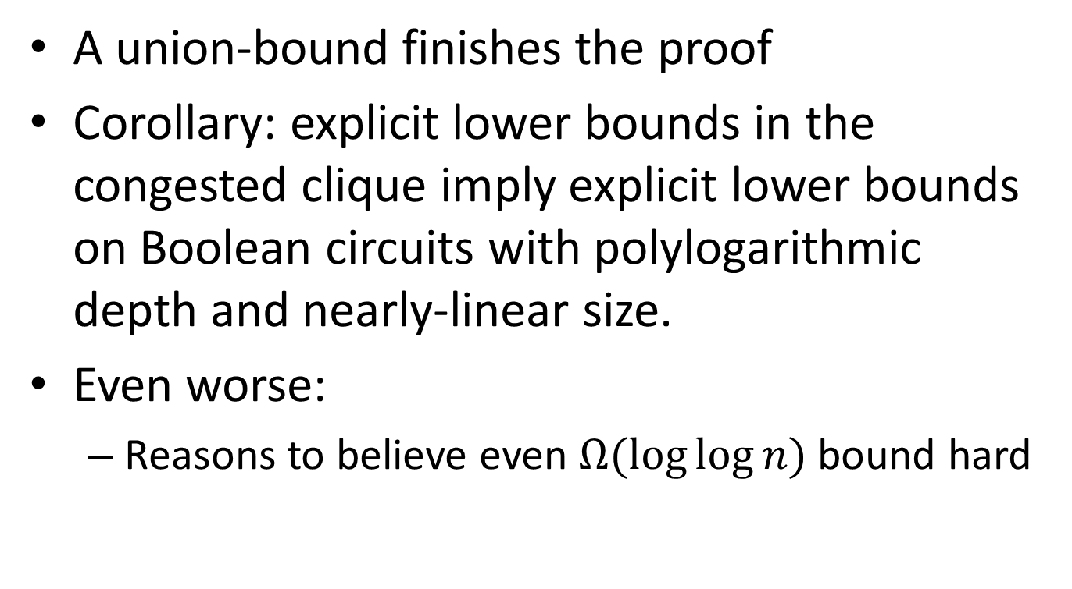
Conversion from Boolean Circuit
A union-bound finishes the proof
Corollary: explicit lower bounds in the congested clique imply explicit lower bounds on Boolean circuits with polylogarithmic depth and nearly-linear size.
Even worse:
  Reasons to believe even $Ω(\log{\log{n}) }$bound hard

Slide 37
Conclusion
LOCAL
CONGESTED CLIQUE
CONGEST / general network
ASYNC MESSAGE-PASSING
X

