Slide 1
Distributed Symmetry Breaking and the Constructive Lovász Local Lemma
Seth Pettie
Kai-Min Chung, Seth Pettie, and Hsin-Hao Su, Distributed algorithms for the Lovász local lemma and
graph coloring, PODC 2014.
L. Barenboim, M. Elkin, S. Pettie, J. Schneider, The locality of distributed symmetry breaking, FOCS 2012.

Slide 2
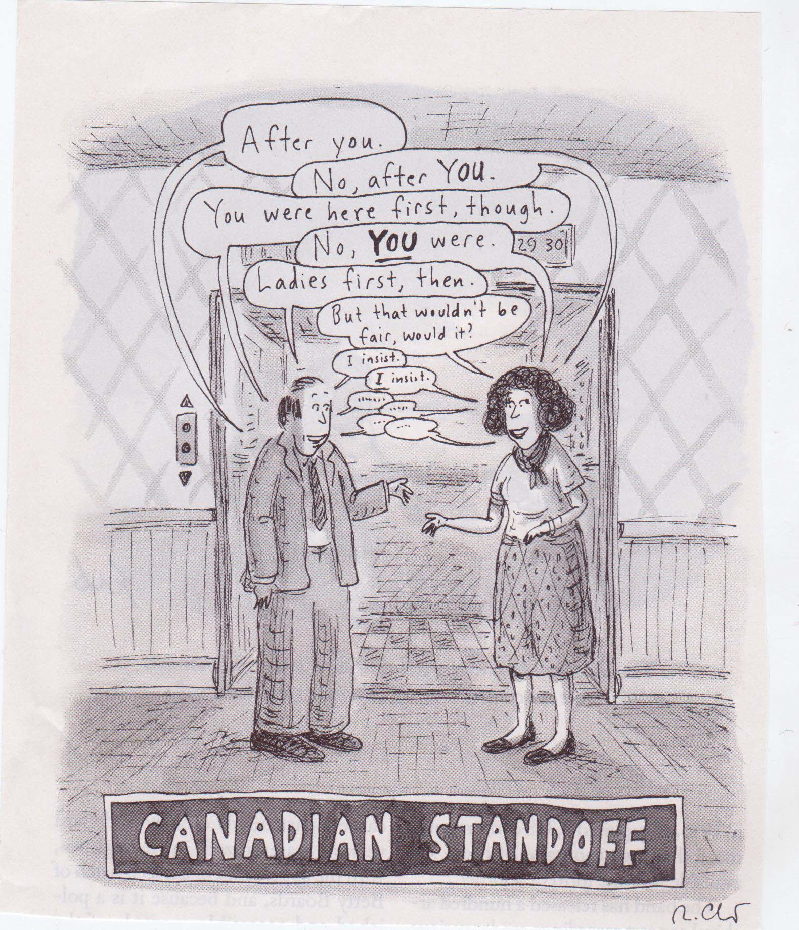

Slide 3
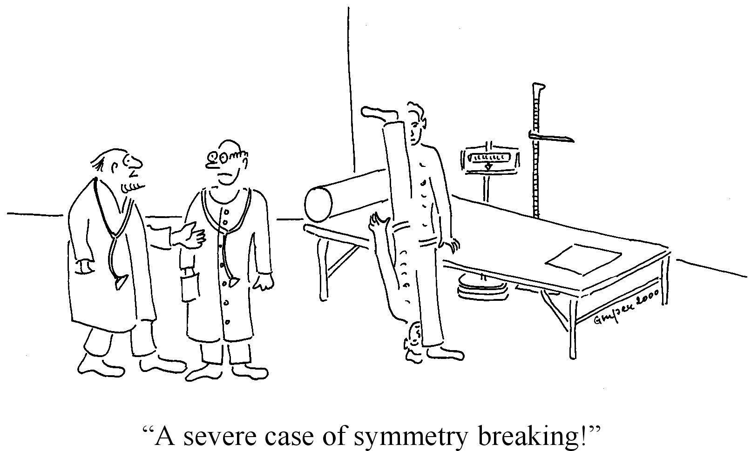

Slide 4
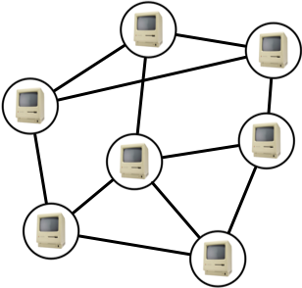
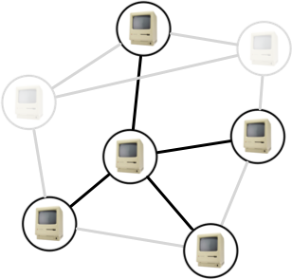
Symmetry Breaking in Distributed Networks
Network is a graph G = (V,E); each node hosts a processor.
Communication is in synchronized rounds
Processors send unbounded messages across E in each round
No one knows what G is!
Nodes know their (distinct) ID and who their neighbors are.
n=|V| nodes — everyone knows n.
max. degree Δ — everyone knows Δ.
Korman, Sereni, and Viennot 2013:
Get rid of this assumption

Slide 5
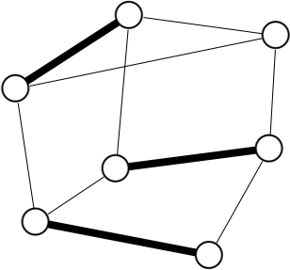
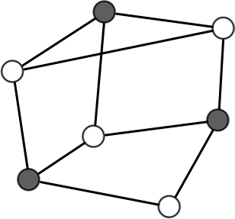
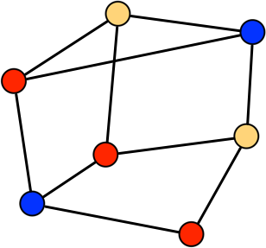
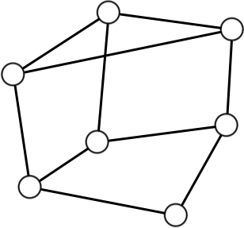
Symmetry Breaking in Distributed Networks
Everyone starts in the same state (except for IDs)
Most things you would want to compute must break this initial symmetry.
MIS (maximal independent set): some nodes are in the MIS, some aren’t
Maximal matching: some edges are in the matching, some aren’t
Vertex/Edge Coloring: adjacent nodes/edges must pick different colors.

Slide 6
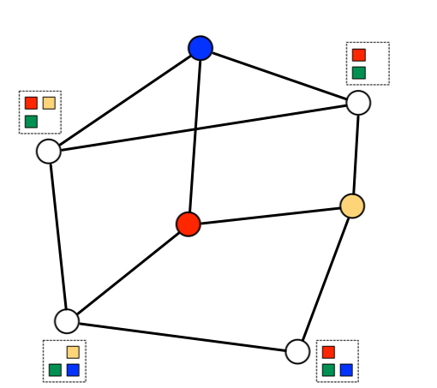
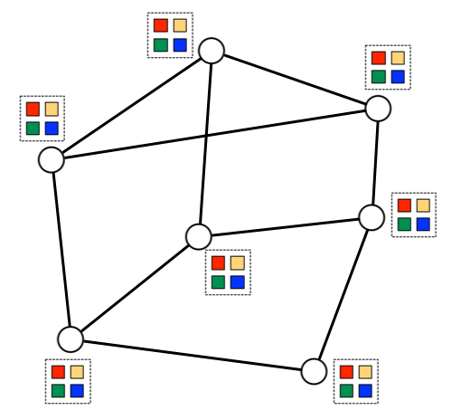
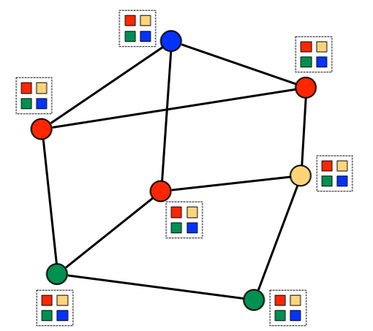
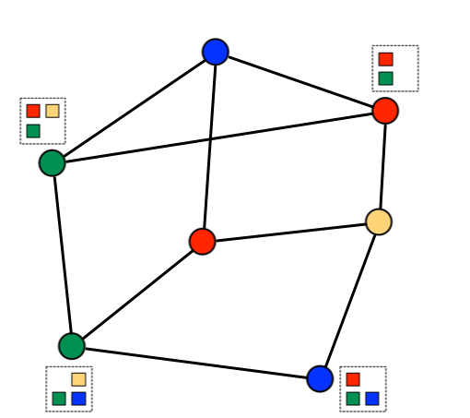
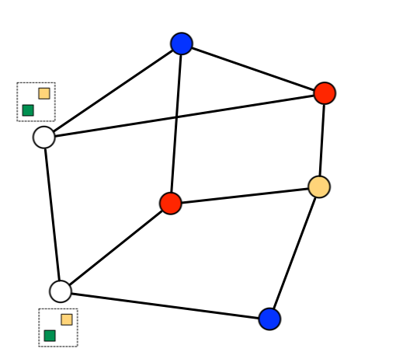
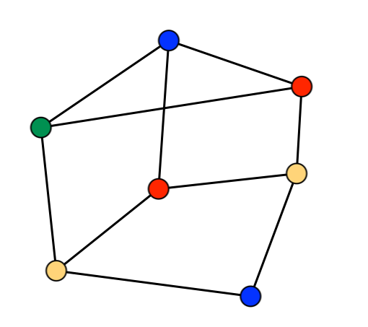
Iterated Randomized Algorithms
The first (Δ+1)-coloring algorithm you’d think of
Everyone starts with the same palette {1, …, Δ+1}
In each round, everyone proposes a palette color at random
Any conflict-free node keeps its color and halts.
Nodes with conflicts withdraw their proposals, update their palettes, and continue.
Analysis: Luby 1986, Johansson 1999, Barenboim, Elkin, Pettie, Schneider 2012

Slide 7
Iterated Randomized Algorithms
The first (Δ+1)-coloring algorithm you’d think of
Claim: In each round, each node is colored with prob. ≥ 1/4.
Claim: Run the algorithm for (c+1)log_{4/3} n rounds. Afterward,
Pr[anyone is uncolored]
≤ n ∙ Pr[a particular node is uncolored] by the union bound
≤ n ∙ n^{-(c+1)} = n^{-c}.
Analysis: Luby 1986, Johansson 1999, Barenboim, Elkin, Pettie, Schneider 2012

Slide 8
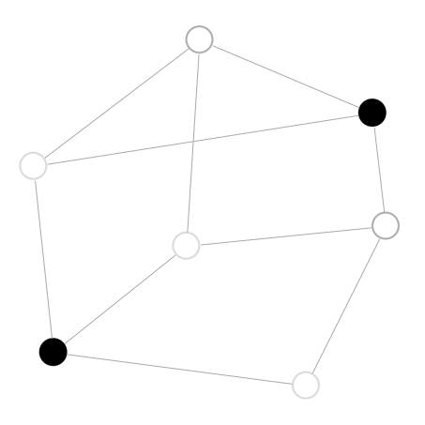
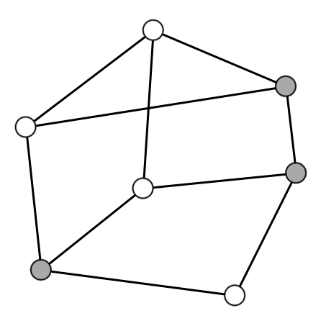
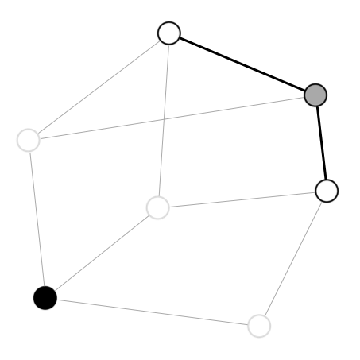
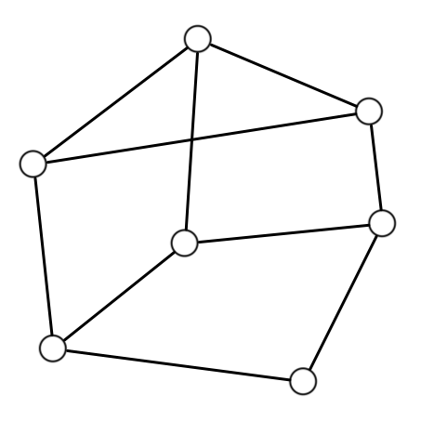
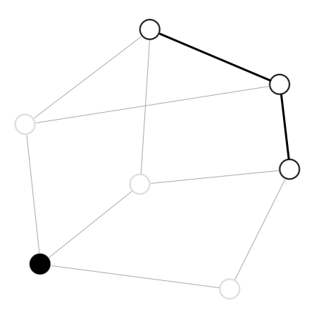
A Randomized MIS Algorithm
Luby 1986, Alon, Babai, Itai 1986
In each round,
v “nominates” itself with probability 1/(deg(v) + 1).
v joins the MIS if it nominates itself, but no neighbor does.
All nodes in MIS or adjacent to an MIS node halt.

Slide 9
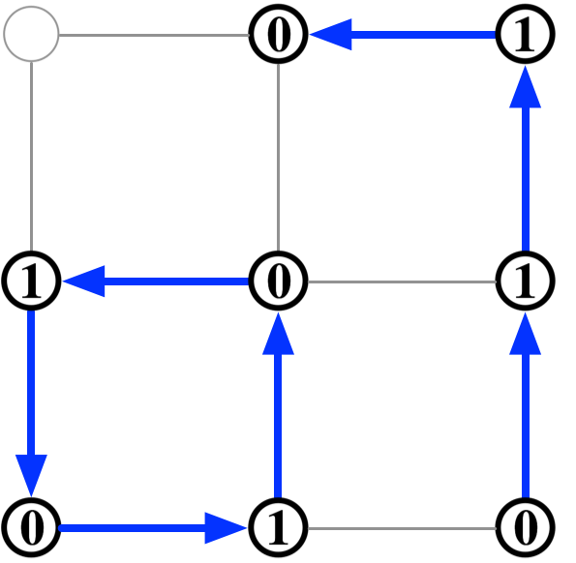
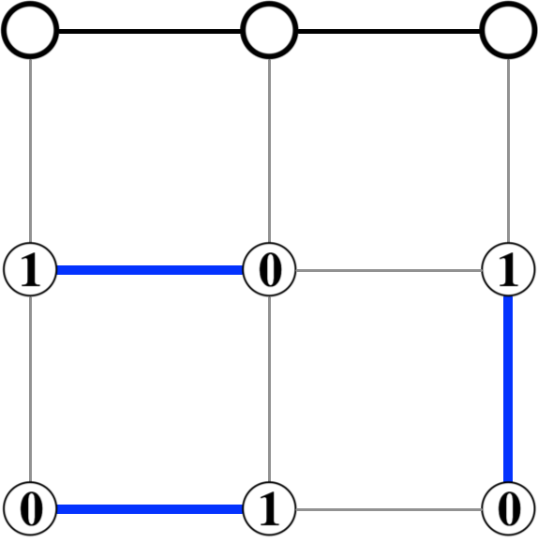
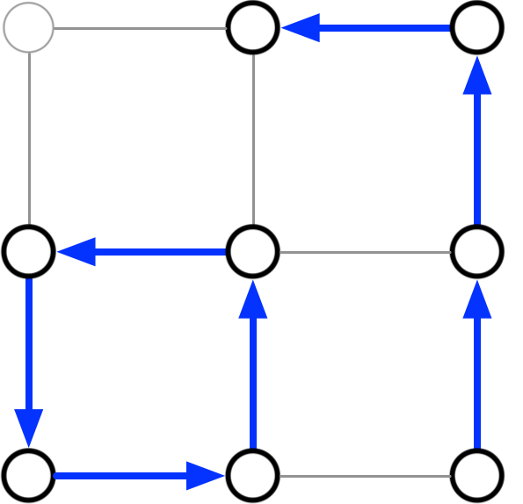
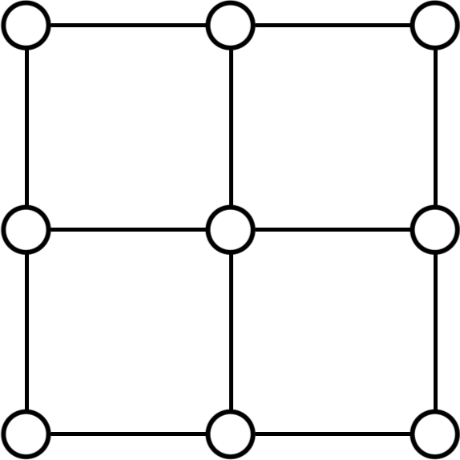
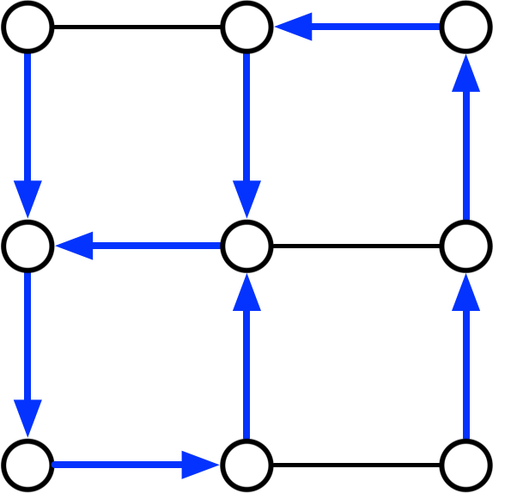
Randomized Maximal Matching Algorithm
Israeli-Itai 1986
1. v proposes to a neighbor prop(v)
Edges { (v,prop(v)) } induce directed pseudoforest.
2. Each v with a proposal accepts one arbitrarily.
Edges induce directed paths and cycles
3. Each node picks a bit ∈ {0,1}.
(v, prop(v)) enters matching if bit(v)=0 and bit(prop(v))=1.

Slide 10
The Union Bound Barrier
These algorithms follow a common template.
Perform O(log n) iterations of some random “experiment”
Some nodes commit to a color
Some nodes get committed to the MIS
Some edges get committed to the matching, etc.
In each iteration, the experiment “succeeds” at a node with constant probability.
Union Bound Barrier:
Expected number of iterations until success is just O(1).
Ω(log n) iterations necessary to ensure global success whp 1-n^{-Θ(1)}.

Slide 11
Getting Around the Union Bound Barrier
A generic two-phase symmetry-breaking algorithm:
Phase I: perform O(log Δ) (or poly(log Δ)) iterations of a randomized experiment with Θ(1) success probability.
Phase II: Apply the best deterministic algorithm on each connected component of the remaining graph.
The guarantee: w.h.p. all remaining connected components have
at most s nodes, s = poly(log n) or poly(Δ)log n.
Run this algorithm for enough time to solve any instance on s nodes

Slide 12
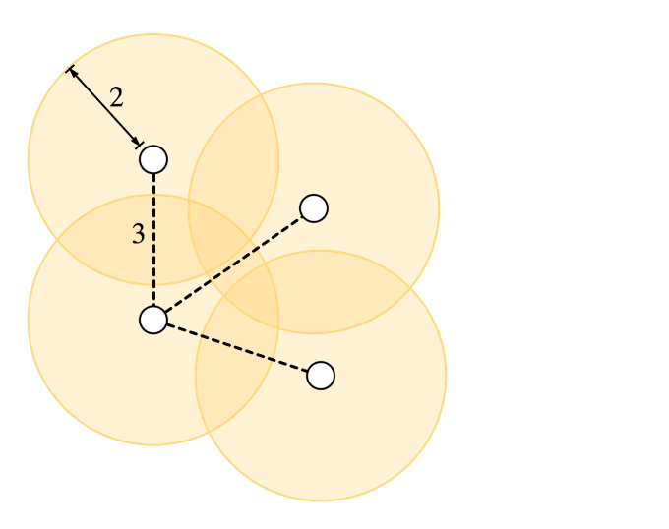
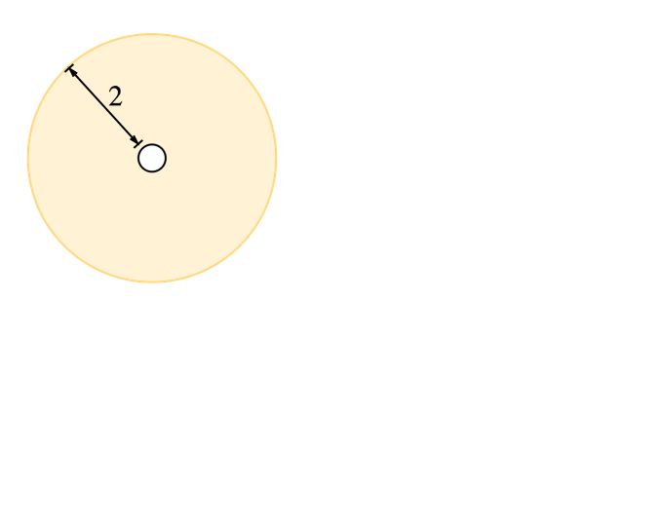
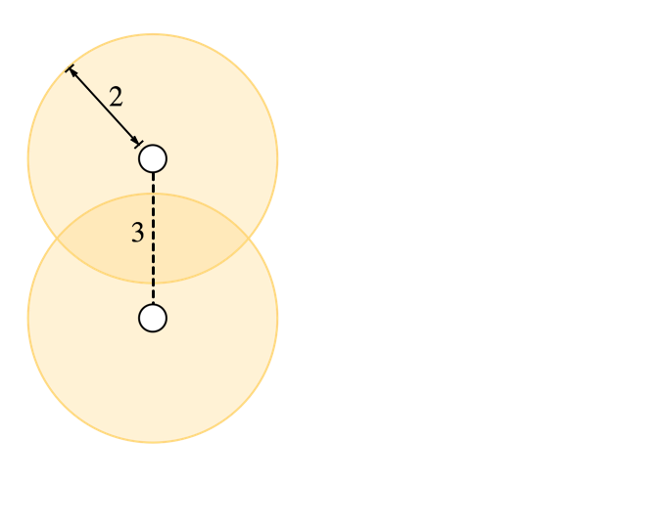
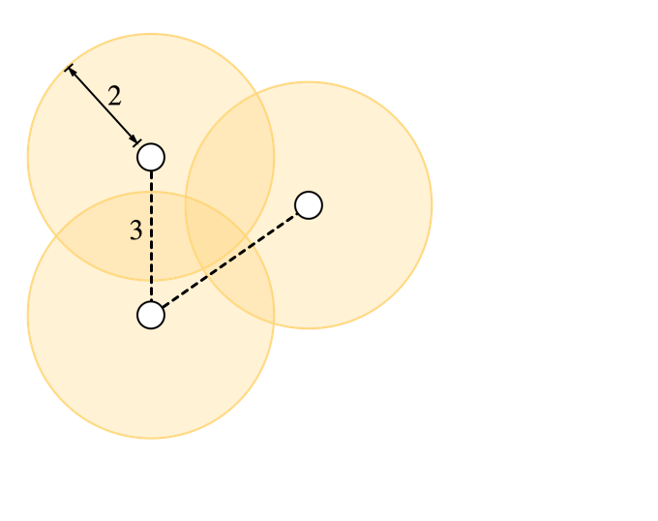
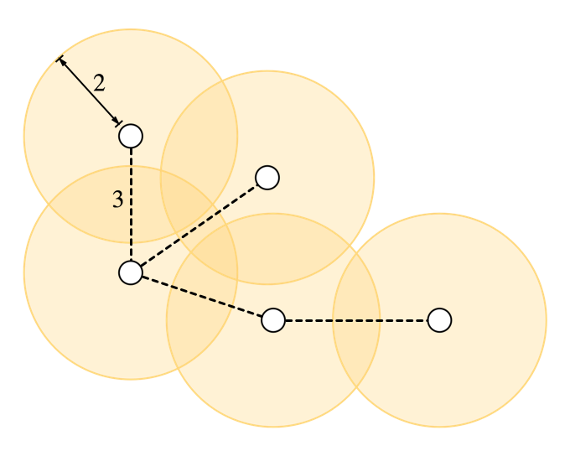
Randomized (Δ+1)-coloring
Whether a node is colored depends only on the color proposals of itself and its neighbors.
→ Nodes at distance 3 behave independently.
Claim: after c log Δ iterations, all connected components have size ≤ Δ²log n, whp.
Proof: Suppose there is such a component with Δ²log n nodes.
Choose an arbitrary node in the component
and remove everything within distance 2.
Repeatedly choose a new node at distance 3
from previously chosen nodes.

Slide 13
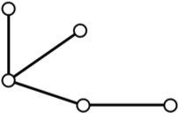
Randomized (Δ+1)-coloring
Claim: after c log Δ iterations, all connected components have size ≤ Δ²log n, whp.
Proof: Suppose there is such a component with Δ²log n nodes.
≤ Δ² nodes removed each time →
≥ log n nodes chosen; all at distance at least 3.
Forms a (log n)-node tree in G³.

Slide 14
Randomized (Δ+1)-coloring
Claim: after c log Δ iterations, all connected components have size ≤ Δ²log n, whp.
Less than 4^{log n} distinct trees on log n nodes.
Less than n ∙ (Δ³)^{log n} ways to embed a tree in G³.
Prob. these log n nodes survive clog Δ iterations: ((3/4)^{clog Δ})^{log n}
→ Prob. any component has size ≥ Δ²log n is less than
4^{log n} ∙ n ∙ (Δ³)^{log n} ∙ ((3/4)^{clog Δ})^{log n} = n^{–Ω(c)}.
first node
each subsequent node

Slide 15
Randomized (Δ+1)-coloring
Phase I:
Perform O(log Δ) iterations of randomized coloring.
→ Degrees in uncolored subgraph decay geometrically to Δʹ = Θ(log n)
(via Chernoff-type concentration bounds)
Perform c log(Δʹ) = O(loglog n) more iterations of randomized coloring.
→ Conn. comp. in uncolored subgraph have size (Δʹ)²log n = O(log³n).
Phase II:
Apply deterministic algorithm to each uncolored component, in parallel.
Improved deterministic algorithms imply improved rand. algorithms!

Slide 16
(Δ+1)-Coloring Algorithms
DETERMINISTIC
Panconesi-Srinivasan 1996
Barenboim-Elkin-Kuhn 2014
RANDOMIZED
Luby 1986, Johansson 1999
Schneider-Wattenhofer 2010
Barenboim-Elkin-Pettie-Schneider 2012

Slide 17
Maximal Independent Set (MIS)
DETERMINISTIC
Panconesi-Srinivasan 1996
Barenboim-Elkin-Kuhn 2014
RANDOMIZED
Luby 1986, Alon-Babai-Itai 1986
Barenboim-Elkin-Pettie-Schneider 2012

Slide 18
Maximal Independent Set (MIS)
DETERMINISTIC
Panconesi-Srinivasan 1996
Barenboim-Elkin-Kuhn 2014
RANDOMIZED
Luby 1986, Alon-Babai-Itai 1986
Barenboim-Elkin-Pettie-Schneider 2012
Kuhn-Moscibroda-Wattenhofer 2010

Slide 19
Maximal Matching
DETERMINISTIC
Hanckowiak-Karonski-Panconesi’96
Panconesi-Rizzi 2001
RANDOMIZED
Israeli-Itai 1986
Barenboim-Elkin-Pettie-Schneider 2012

Slide 20
Maximal Matching
DETERMINISTIC
Hanckowiak-Karonski-Panconesi’96
Panconesi-Rizzi 2001
RANDOMIZED
Israeli-Itai 1986
Barenboim-Elkin-Pettie-Schneider 2012
Kuhn-Moscibroda-Wattenhofer 2010

Slide 21
MIS, Maximal Matching, and (Δ+1)-coloring are “easy” problems.
Existence is trivial.
Linear-time sequential algorithms are trivial.
Any partial solution can be extended to a full solution.
Lots of problems don’t have these properties
(1+o(1))Δ-edge coloring
“Frugal” coloring
“Defective” coloring
O(Δ/log Δ)-coloring triangle-free graphs

Slide 22
Defective Coloring
f-defective r-coloring:
Vertices colored from palette {1, …, r}
Each vertex shares its color with ≤ f neighbors.
A (5log n)-defective (Δ/log n)-coloring algorithm:
Expected number of neighbors sharing color ≤ log n.
Pr[5log n neighbors share color] ≤ 1/poly(n). (Chernoff)
Kuhn-Wattenhofer 2006, Barenboim-Elkin 2013
Step 1: every node chooses a random color.

Slide 23
Defective Coloring
How about (5log Δ)-defective (Δ/log Δ)-coloring?
Step 1: every node chooses a random color.
If Δ≪log n then this almost certainly isn’t a good coloring.
Violations at v and w are dependent only if dist(v,w) ≤ 2.
Step 2: somehow fix all the violations (without creating more)
(Chernoff)
Notes:
(e/5)^4 / 5

Slide 24
The (Symmetric) Lovász Local Lemma
Lovász, Erdős 1975
There are n “bad” events E₁, E₂, …, E_{n}.
(1) Pr(E_{i}) ≤ p.
(2) E_{i} is independent of all but d other events.
(3) ep(d+1) < 1
→
Great for proofs of existence!
We want a (distributed) constructive version:

Slide 25
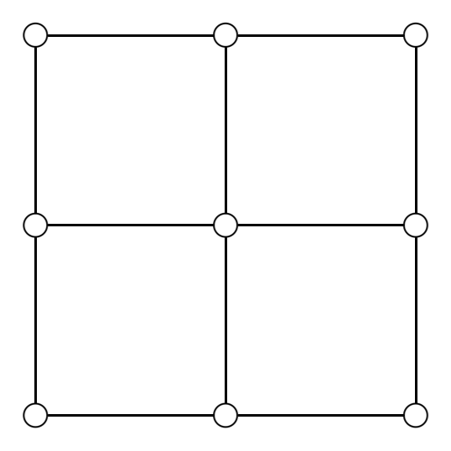
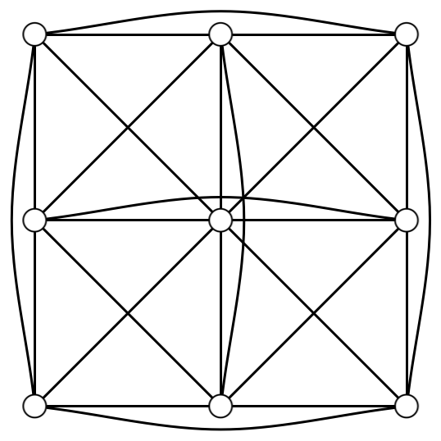
Nodes generate some random bits
E_{i} depends on bits within distance t of node i
Dependency graph is G^{2t}. Maximum degree is d ≤ Δ^{2t}.
Distributed algorithms in G^{2t} can be simulated in G with O(t) slowdown.
The dependency graph

Slide 26
The Moser-Tardos L.L.L. Algorithm [2010]
1. Choose a random assignment to the underlying variables.
2. Repeat
V = set of bad events that hold under the current assignment
I = MIS(V ) {any MIS in the subgraph induced by V }
Resample all variables that determine events in I .
3. Until V = ∅
O(log_{1/ep(d+1)} n) iterations sufficient, whp.
→ O(MIS ∙ log_{1/ep(d+1)} n) rounds in total.
Linial 92, Kuhn, Moscibroda,
Wattenhofer 2010

Slide 27
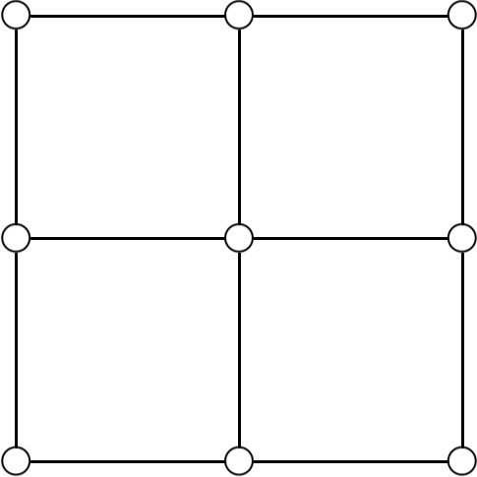
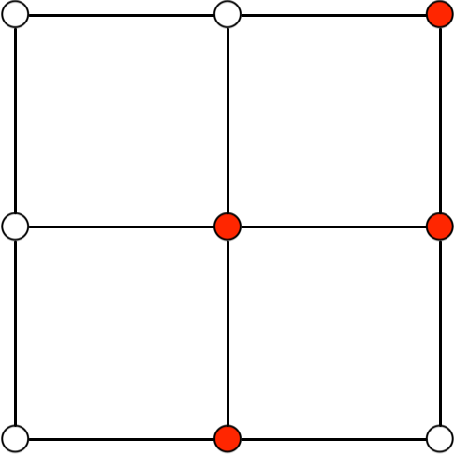

Slide 28
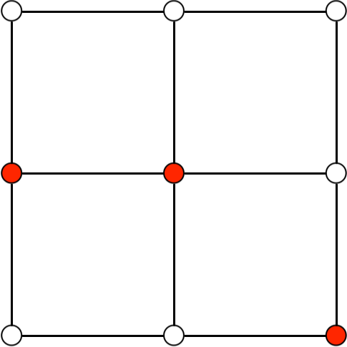

Slide 30
Overview of the Moser-Tardos Analysis
(1) Transcribe the behavior of the algorithm
Resampling log: list of events whose variables were resampled.
(2) Build rooted witness trees
Nodes labeled with resampled events in the log.
Non-roots represent history of how the root-node event came to be resampled.
Deep witness tree → long execution of the algorithm.
(3) Bound the probability a particular witness tree exists; count witness trees; apply union bound.

Slide 31
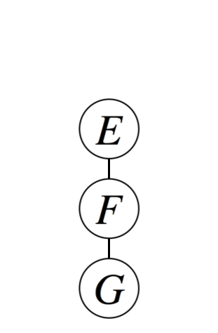
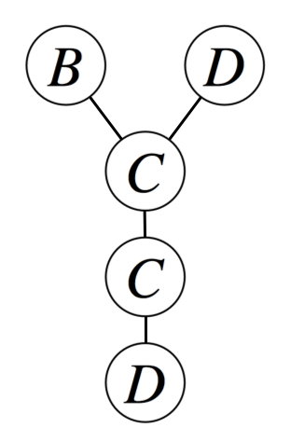
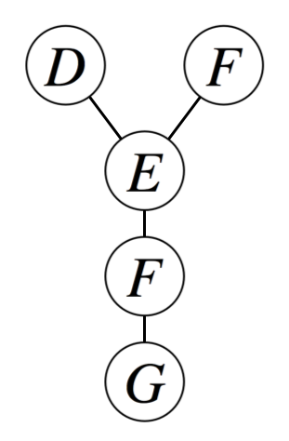
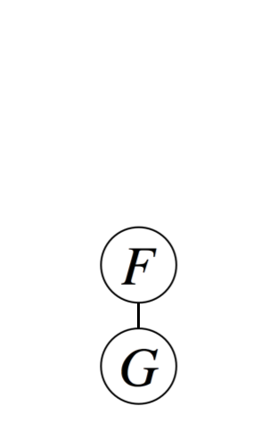
The dependency graph:
MIS 1
MIS 2
MIS 3
MIS 4
Resampling transcript: BDF | CE | CF | DG

Slide 32
Moser-Tardos [2010] analysis
Prob. a particular witness tree with size t occurs: p^{t}.
Number of such trees: n∙e^{t}(d+1)^{t}
Prob. any witness tree with size ≥ k occurs:
which is 1/poly(n) when
k = O(log_{1/ep(d+1)} n)
Must be less than 1

Slide 33
A simpler L.L.L. Algorithm
Chung, Pettie, Su 2014
1. Arbitrarily assign distinct ids to events.
2. Choose a random assignment to the variables.
3. Repeat
V = set of bad events that hold under the current assignment
I = {E ∈V | id(E) < id(F), for all neighbors F ∈V }
Resample all variables that determine events in I .
4. Until V = ∅

Slide 34
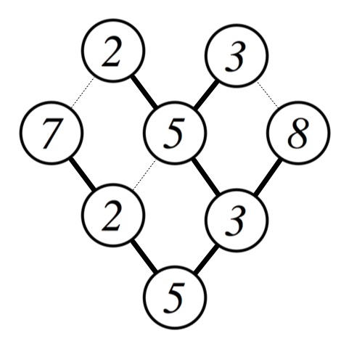
Local Minima 1
Local Minima 2
Local Minima 3
Local Minima 4
Resampling transcript: 23 | 758 | 23 | 5
To build a 2-witness tree T:
Scan each event E in the transcript in
time-reverse order
If ∃F-node in T with dist(E,F) ≤ 2,
Attach E-node to the deepest such F.

Slide 35
Chung, Pettie, Su [2014]
Prob. a particular 2-witness tree with size t occurs ≤ p^{t}.
Number of such trees < n∙e^{t}(d²)^{t}
Prob. any witness tree with size ≥ k occurs:
Also: another O(log²d ∙ log_{1/ep(d+1)} n) L.L.L. algorithm under the standard criterion ep(d+1) < 1.
which is 1/poly(n) when
k = O(log_{1/epd}2 n)
Must be less than 1

Slide 36
A Take-Home Message
Proof of existence for
object X using the L.L.L.
a distributed
L.L.L. algorithm
a distr. algorithm for finding object X.
+
=
f-defective O(Δ/f)-coloring, f=Ω(log Δ).
O(Δ/log Δ)-coloring triangle-free graphs.
(1+ε)Δ-edge coloring
k-frugal (Δ+1)-coloring, k = Θ(log²Δ/loglogΔ)
≤ k nodes have same color in any neighborhood.
(1+ε)D-list coloring
Each color appears in ≤ D lists in neighborhood nodes.
D unrelated to Δ.

Slide 37
What’s the distributed complexity of L.L.L.?
O(1)-coloring the n-cycle takes Ω(log* n) time.
O(1)-coloring of the n-cycle guaranteed by L.L.L.
→ Any distrib. L.L.L. algorithm takes Ω(log* n) time
even under any criterion , e.g.,
All deterministic L.L.L. algorithms are intrinsically centralized.
Is there a deterministic distributed L.L.L. algorithm for some criterion ?
Linial 1992
Chandrasekaran-Goyal-Haeupler 2013, Alon 1991,
Beck 1991, Molloy-Reed 1998, Moser-Tardos 2010

Slide 38
Conclusions
Randomization is natural tool for solving symmetry breaking problems
Two problems with randomization:
It’s hard/impossible to beat polylog(n) with purely random strategies. Is reversion to a deterministic strategy inevitable?
The L.L.L. gives success probability > 0. Is there a deterministic L.L.L. algorithm for amplifying this to probability 1? All known deterministic L.L.L. algorithms don’t work in distributed networks.

Slide 39
Hook ’em

