Slide 1
Automatically Speeding Up
LOCAL Algorithms
Seth Pettie
University of Michigan
Joint work with Yi-Jun Chang
Naor, Stockmeyer, SICOMP 1995
Chang, Kopelowitz, Pettie, FOCS 2016
Chang, Pettie, FOCS 2017, SICOMP 2018

Slide 2

The LOCAL Model
[Linial’92]
A graph G=(V,E)
  Vertex = processor
  Edge = bidirected communication
  Time: synchronized rounds. In
  each round, each vertex sends a
  message to each neighbor.
  Computation is free.
  Message size is unbounded.
  “Time” = number of rounds
Randomized LOCAL
  Can generate an unbounded number of random bits

Slide 3
The LOCAL Model
[Linial’92]
What a vertex v knows:
  Global graph parameters: n = |V|, Δ = max_{u} deg(u)
  A unique O(log n)-bit ID(v).
  A port-numbering of its deg(v) incident edges.

Slide 4

The LOCAL Time Hierarchy
Q: Which time complexities are obtainable by “natural” problems.
  To reduce the number of problem parameters, assume $Δ=O(1)$.

Slide 5
What is a “natural problem” ?
[Naor-Stockmeyer’95]
Locally Checkable Labeling (LCL) problem: NTIME(O(1))
  Input and Output alphabets Σ_{in}, Σ_{out}, integer radius r.
    |Σ_{in}|, |Σ_{out}| may depend on Δ, but are independent of n.
  Set C of acceptable radius-r centered subgraphs.
Problem: given V➝Σ_{in}, compute V➝Σ_{out} such that every vertex’s radius-r view is in C.
v
radius-1 view from v
some acceptable configurations for 3-coloring.
an unacceptable
configuration

Slide 6
Greedy vs. Nongreedy LCL Problems
The canonical greedy problems:
  Maximal independent set
  Maximal matching
  (Δ+1)-vertex coloring
  (2Δ–1)-edge coloring
Some non-greedy problems
  (approximate) maximum matching
  Sinkless orientation
  Δ-vertex coloring
  (2Δ-2)-edge coloring
  Frugal coloring
  Defective coloring
  Versions of List coloring, etc.
every partial solution extends
to a total solution

Slide 7
Time Hierarchies: Δ=O(1)
1. O(Δ²)-color the graph in log*n time. [Linial’s algorithm ‘92]
2. Apply greedy algorithm to each color class, one at a time.
all greedy problems
all problems

Slide 8
Time Hierarchies: Δ=O(1)
Naor, Stockmeyer’95
via hypergraph Ramsey argument…
any O(1) time algorithm can be made
order-invariant w.r.t. vertex IDs.
In O(log* n) time, we can make all vertices
think they are in an O(1)-size path/cycle/grid/torus.
Chang, Pettie’17
Brandt, Hirvonen, Korhonen, Lempiäinen, Östergård, Purcell, Rybicki, Suomela’17
Chang, Kopelowitz, Pettie’16
Brandt, Hirvonen, Korhonen, Lempiäinen, Östergård, Purcell, Rybicki, Suomela’17

Slide 9
Time Hierarchies: Δ=O(1)
General graphs, Trees
Naor, Stockmeyer’95
Chang, Pettie’17

Slide 10
Time Hierarchies: Δ=O(1)
General graphs, Trees
Chang, Kopelowitz, Pettie’16
Deterministic
Randomized
Exponential Separations:
– Δ-coloring degree-Δ trees
– Sinkless Orientation
– (2Δ-2)-edge coloring trees
Brandt, Fischer, Hirvonen, Keller,
Lempiäinen, Rybicki, Suomela, Uitto’16
Chang, Kopelowitz, Pettie’16
Pettie, Su’15
Ghaffari, Su’17
Chang, He, Li, Pettie, Uitto’18

Slide 11
Time Hierarchies: Δ=O(1)
General graphs, Trees
An infinite number of complexities.
“k-level 2½-coloring” needs Θ(n^{1/k}) time
Deterministic
Randomized
Lovász Local Lemma is “complete” for sublogarithmic randomized time!
Every o(log n)-time randomized algorithm can be
automatically sped up to run in O(LLL) time.

Slide 12
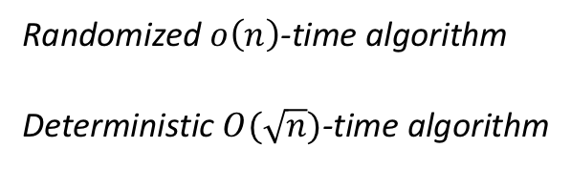
Time Hierarchies: Δ=O(1)
Trees
Deterministic
Randomized n^{o(1)}-time algorithm
Deterministic O(log n)-time algorithm
Randomized
Chang, Pettie’17
Randomized $o\left(n\right)$-time algorithm
Deterministic $O(\sqrt{n})$-time algorithm
Balliu, Brandt, Olivetti,
Suomela’18
Remaining gaps…
Chang (unpublished)

Slide 13
Time Hierarchies: Δ=O(1)
Trees
The Ramsey Gap
The Graph Shattering Gaps
The LLL Gap
The Pumping Lemma Gaps
Deterministic
Randomized

Slide 14
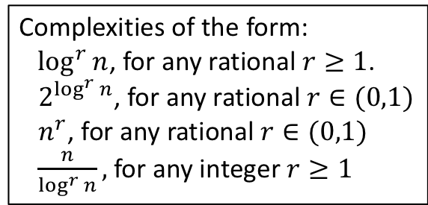
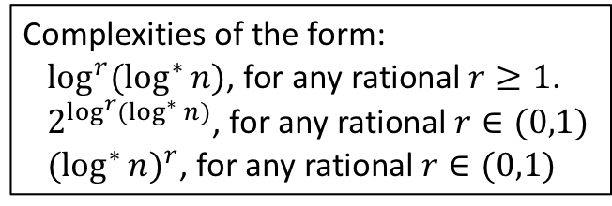
Time Hierarchies: Δ=O(1)
General Graphs
Deterministic
dense
dense
Complexities of the form:
$\log^{r}{n}$, for any rational $r≥1$.
$2^{\log^{r}{n}}$, for any rational $r∈(0,1)$
$n^{r}$, for any rational $r∈(0,1)$
$\frac{n}{\log^{r}{n}},$for any integer $r≥1$
Randomized
Complexities of the form:
$\log^{r}{(\log^{∗}{n)}}$, for any rational $r≥1$.
$2^{\log^{r}{(\log^{∗}{n)}}}$, for any rational $r∈(0,1)$
${(\log^{∗}{n})}^{r}$, for any rational $r∈(0,1)$
Balliu, Hirvonen, Korhonen, Keller,
Lempiäinen, Olivetti, Suomela 2018
Balliu, Brandt, Olivetti, Suomela 2018

Slide 15
Little white lies
What does “n” refer to in the LOCAL model?
  (1) n = |V| = size of the graph.
  (2) O(log n) = bits in vertex IDs.
  (3) 1/poly(n) = standard error bound for randomized algs.

Slide 16
The Ramsey Gap
[Naor-Stockmeyer’95], [Chang-Pettie’17]
Step 1: Show that any sufficiently fast algorithm can be made “order invariant.”
Step 2: Show that any order invariant algorithm can be tricked into thinking n=O(1).
General algorithm
Order-invariant algorithm
…
Z = MSB(ID(u) XOR ID(v))
…
…
If (ID(u) < ID(v)) then
…
Else
….
…

Slide 17
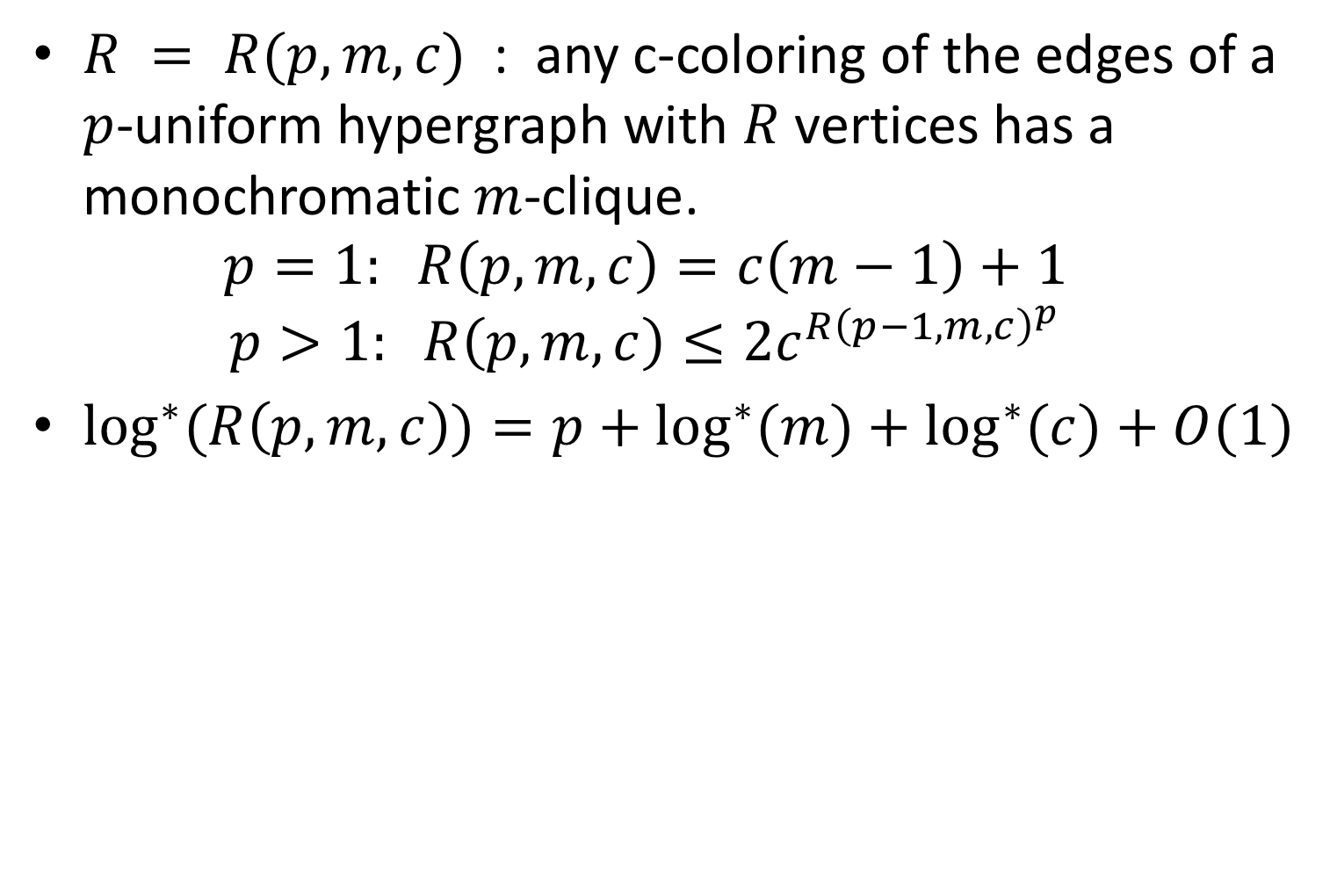
$R = R(p,m,c)$ : any c-coloring of the edges of a $p$-uniform hypergraph with $R$ vertices has a monochromatic $m$-clique.
  $$p=1: R\left(p,m,c\right)=c\left(m−1\right)+1$$
  $$p>1: R\left(p,m,c\right)≤2c^{R{\left(p−1,m,c\right)}^{p}}$$
$\log^{∗}{(R\left(p,m,c\right))}=p+\log^{∗}{(m)}+\log^{∗}{(c)}+O(1)$

Slide 18
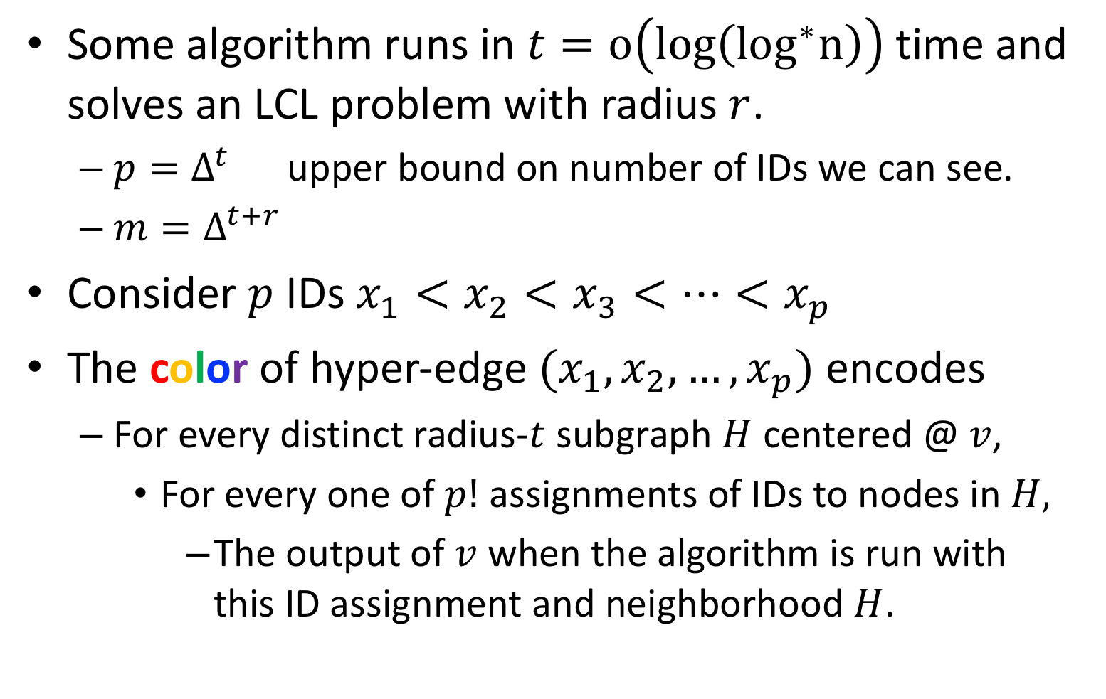
Some algorithm runs in $t=o\left(log\left(\log^{∗}n\right)\right)$ time and solves an LCL problem with radius $r$.
  $p=Δ^{t}$ upper bound on number of IDs we can see.
  $m=Δ^{t+r}$
Consider $p$ IDs $x_{1}<x_{2}<x_{3}<⋯<x_{p}$
The color of hyper-edge $(x_{1},x_{2},…,x_{p})$ encodes
  For every distinct radius-$t$ subgraph $H$ centered @ $v$,
    For every one of $p!$ assignments of IDs to nodes in $H,$
      The output of $v$ when the algorithm is run with this ID assignment and neighborhood $H$.

Slide 19



There exists a monochromatic $m$-clique. W.l.o.g., suppose $S = \{1,2,3,…,m\}$is monochromatic.
New algorithm: $H$ = $t$-neighborhood of $v$. Reassign IDs in $H$ to be from $S$ in an order-preserving way. Run the old algorithm.
$$t=2, r=1$$
Map IDs to $\{2,3,6,7,8,9,10,11,14\}$

Slide 20

There exists a monochromatic $m$-clique. W.l.o.g., suppose $S = \{1,2,3,…,m\}$is monochromatic.
New algorithm: $H$ = $t$-neighborhood of $v$. Reassign IDs in $H$ to be from $S$ in an order-preserving way. Run the old algorithm.
$$t=2, r=1$$

Slide 21
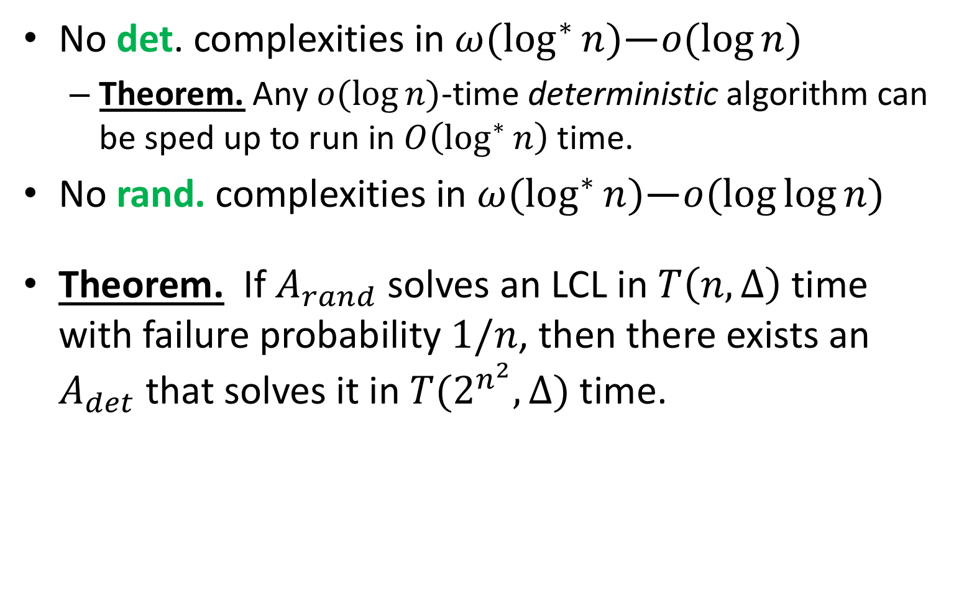
The “Graph Shattering” Gaps
[Chang, Kopelowitz, Pettie’16]
No det. complexities in $ω(\log^{∗}{n})$—$o(\log{n)}$
  Theorem. Any $o(\log{n)}$-time deterministic algorithm can be sped up to run in $O\left(\log^{∗}{n}\right)$ time.
No rand. complexities in $ω(\log^{∗}{n})$—$o(\log{\log{n}})$
Theorem. If $A_{rand}$ solves an LCL in $T\left(n,Δ\right)$ time with failure probability $1/n$, then there exists an $A_{det}$ that solves it in $T(2^{n^{2}},Δ)$ time.
Alt. proof: [Fischer, Ghaffari’17]

Slide 22
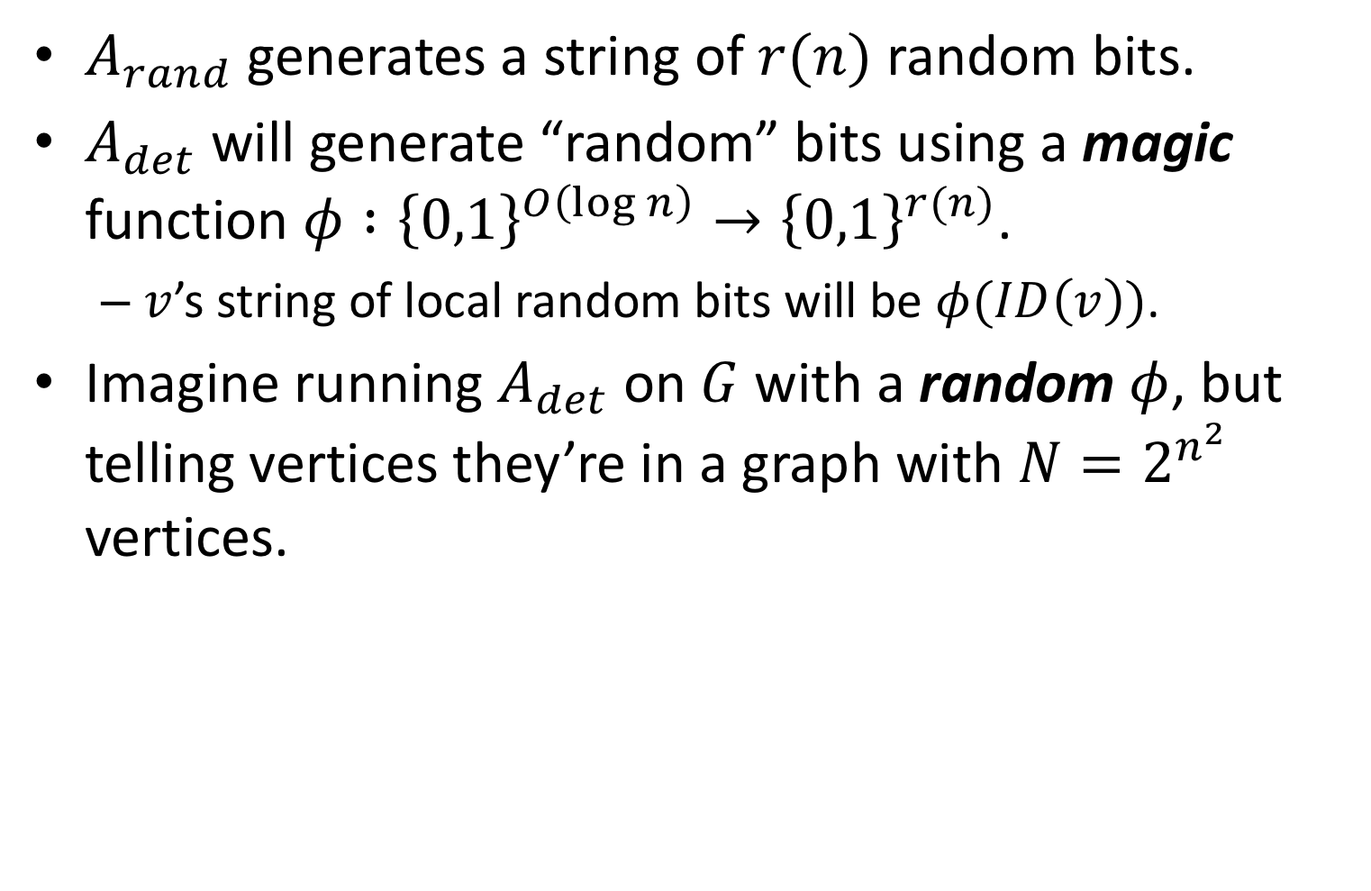
Derandomization
$A_{rand}$ generates a string of $r(n)$ random bits.
$A_{det}$ will generate “random” bits using a magic function $φ :{\left\{0,1\right\}}^{O\left(\log{n}\right)}→{\left\{0,1\right\}}^{r(n)}$.
  $v$’s string of local random bits will be $φ(ID\left(v\right))$.
Imagine running $A_{det}$ on $G$ with a random $φ$, but telling vertices they’re in a graph with $N=2^{n^{2}}$ vertices.
Probability of failure < 1/N.

Slide 23
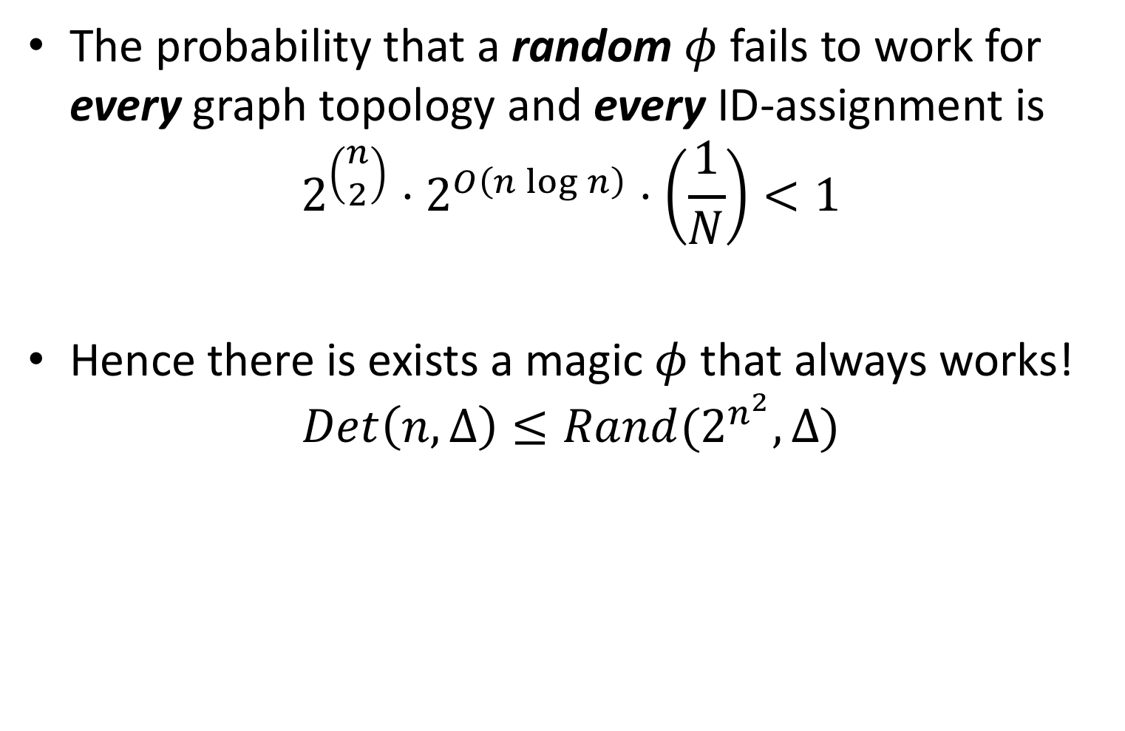
The probability that a random $φ$ fails to work for every graph topology and every ID-assignment is
$$2^{\left(\begin{matrix}n \\ 2\end{matrix}\right)}⋅2^{O\left(n\log{n}\right)}⋅\left(\frac{1}{N}\right)<1$$
Hence there is exists a magic $φ$ that always works!
$$Det\left(n,Δ\right)≤Rand(2^{n^{2}},Δ)$$
Number of
graphs
Number of ID
assignments
Failure prob.

Slide 24

A Randomized Complexity Gap
Theorem. No randomized LCL complexities in $ω(\log^{∗}{n)}$—$o(\log{\log{n})}$.
  Proof. Suppose $A_{rand}$ solves some LCL in $o(\log{\log{n)}}$ time.
  This implies an $A_{det}$ that solves it in $o(\log{n})$ time.
  Any deterministic $o(\log{n)}$-time algorithm can be sped up to run in $O(\log^{∗} n)$ time. [Chang, Kopelowitz, Pettie’16]

Slide 25
The Lovasz Local Lemma Gap
The distributed (symmetric) LLL problem:
  Network and dependency graph G=(V,E) are identical
  V : “bad events”; u∈V depends on set of discr. r.v.s vbl(u)
  E = {(u,v) : vbl(u) ∩ vbl(v) ≠ ∅}
  d = maximum degree in G, p = maximum Pr(v).
    Satisfies some LLL Criterion, e.g., ep(d+1) <1, p(ed)^{c} < 1.
Compute a variable assignment such that no bad event occurs.

Slide 26

Suppose $A$ solves some LCL problem in sublogarithmic time with failure probability $1/n$.
  For any ε>0, can write time as $T\left(n,Δ\right)≤ C\left(Δ\right)+ε\log_{Δ}{n}$
$n^{∗}$= min. value such that: $T\left(n,Δ\right)=t^{∗}≤\frac{1}{2c}\log_{Δ}{n^{∗}}−O(1)$
  Follows that $t^{∗}=O\left(C\left(Δ\right)\right)$.
every vertex sees a subgraph that is
consistent with an n*-vertex graph.

Slide 27
Build the dependency graph:
  X_{v} = the random bits generated locally at v.
  vbl(v) = {X_{u} | u ∈ N^{t*+O(1)}(v)}
  E_{v} = the event that v’s neighborhood is incorrectly
  labeled, when running alg. A with “n” = n*.
  H = ({E_{v}}, {(E_{u},E_{v}) | dist(u,v) ≤ 2t*+O(1) })
  LLL parameters: p = 1/n*, d = Δ^{2t*+O(1)}
Run a distributed LLL algorithm on “H.”
  1 step in H simulated with O(C(Δ)) steps in G.
  Alg. A can be automatically sped up to O(C(Δ)∙T_{LLL}) time.

Slide 28

Pumping Lemma Speedups
Theorem: any randomized $n^{o\left(1\right)}$-time LCL algorithm on trees can be converted into a deterministic $O(\log{n})$-time algorithm.

Slide 29
Rake and Compress
[Miller and Reif 1989]

Slide 30
Rake and Compress
[Miller and Reif 1989]
Rake: remove all leaves

Slide 31
Rake and Compress
[Miller and Reif 1989]
Rake: remove all leaves
Compress: remove chains of degree-2 vertices.

Slide 32
Rake and Compress
[Miller and Reif 1989]
Rake: remove all leaves
Compress: remove chains of degree-2 vertices.

Slide 33
Rake and Compress
[Miller and Reif 1989]
Rake: remove all leaves
Compress: remove chains of degree-2 vertices.

Slide 34
Rake and Compress
[Miller and Reif 1989]
Rake: remove all leaves
Compress: remove chains of degree-2 vertices.
O(log n) rakes & compresses suffice.

Slide 35
Rake and Compress
[Miller and Reif 1989]
Case 1: O(log n) rakes suffice to decompose the tree
  Diam. = O(log n); any LCL can be solved in O(log n) time.
Case 2: compress occasionally removes ω(1)-length paths.

Slide 36
Removing Long Paths
[Miller and Reif 1989]
A sufficiently long path of nodes removed in i^{th} iteration
Subtrees removed in iterations < i.
Bookended by nodes removed in iteration > i.

Slide 37
Removing Long Paths
[Miller and Reif 1989]
A sufficiently long path of nodes removed in i^{th} iteration
Subtrees removed in iterations < i.
Bookended by nodes removed in iteration > i.
Can assume w.l.o.g. that the path has length O(1) by “promoting” a well-spaced set of nodes to level-(i+1).

Slide 38
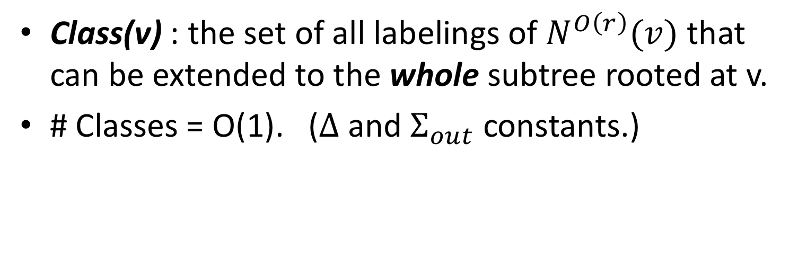
Class
Class(v) : the set of all labelings of $N^{O\left(r\right)}(v)$ that can be extended to the whole subtree rooted at v.
# Classes = O(1). ($Δ$ and $Σ_{out}$ constants.)

Slide 39
Type
c_{i} = Class(v_{i})
Relevant information (c₁, c₂, c₃, …)

Slide 40
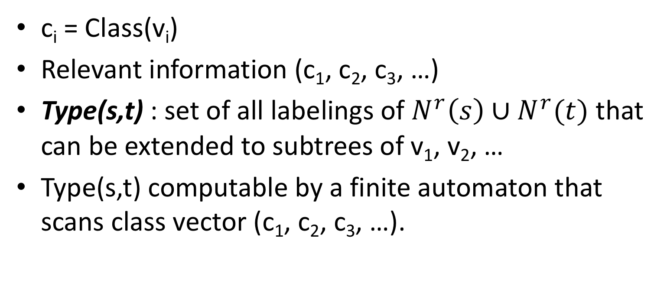
Type
c_{i} = Class(v_{i})
Relevant information (c₁, c₂, c₃, …)
Type(s,t) : set of all labelings of $N^{r}\left(s\right)∪N^{r}(t)$ that can be extended to subtrees of v₁, v₂, …
Type(s,t) computable by a finite automaton that scans class vector (c₁, c₂, c₃, …).

Slide 41
Pumping Trees
If the path is sufficiently long, the automaton will enter some state twice.
Can create a “pumped” tree; Type(s,t) is unchanged.

Slide 42
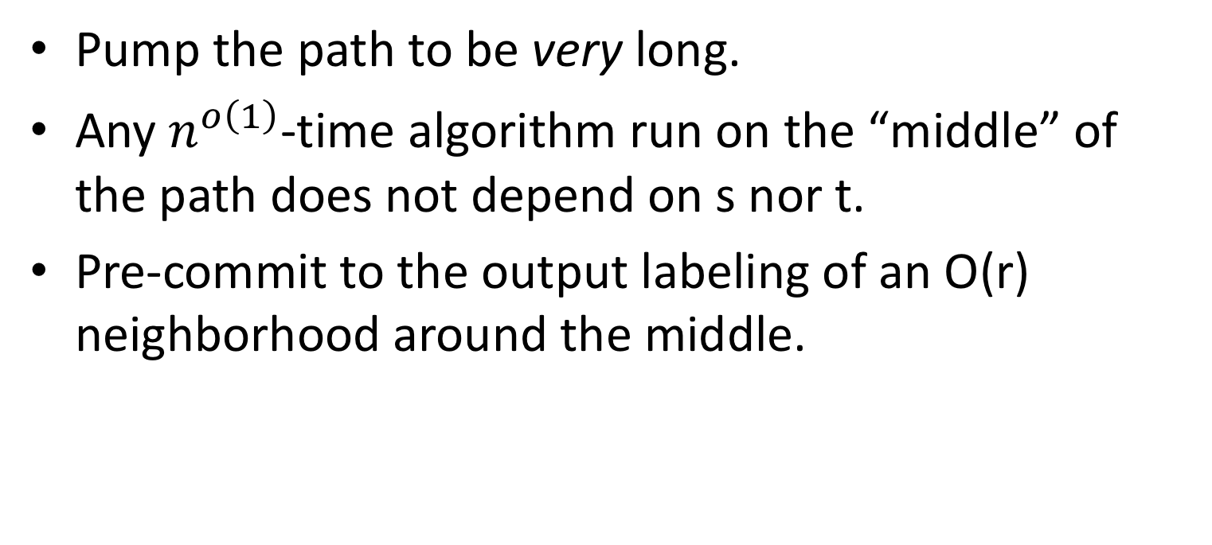
Pumped Trees
Pump the path to be very long.
Any $n^{o\left(1\right)}$-time algorithm run on the “middle” of the path does not depend on s nor t.
Pre-commit to the output labeling of an O(r) neighborhood around the middle.

Slide 43
Duplicate the path. s and t can color their sections
independently and combine their solutions.

Slide 44
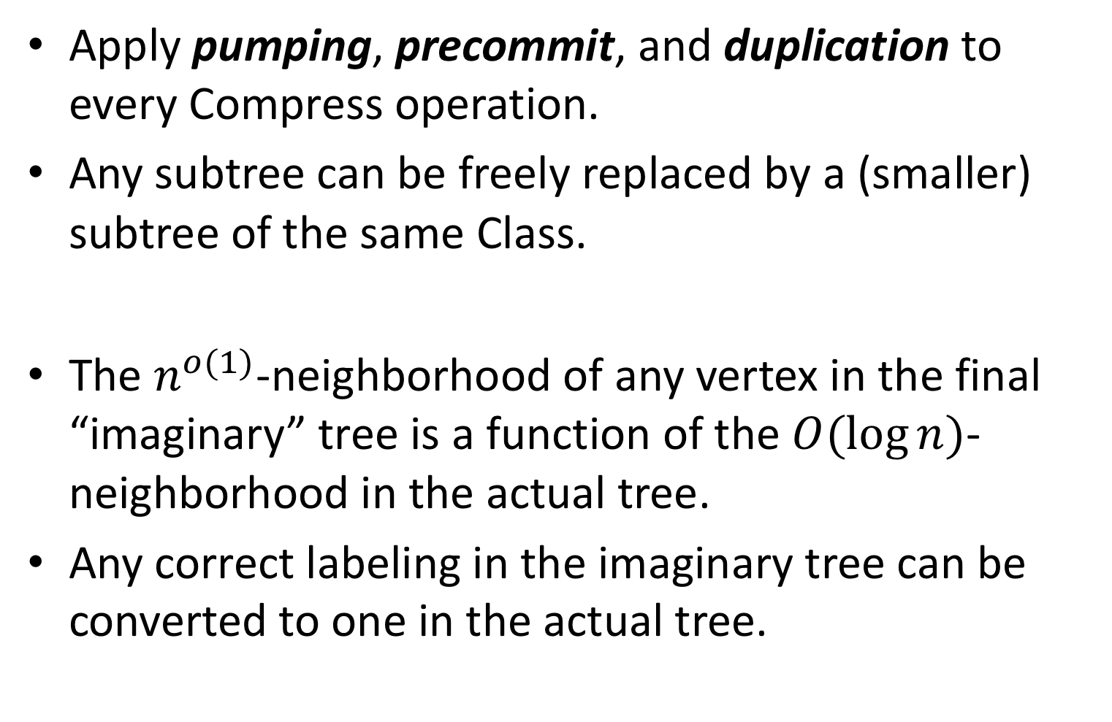
Apply pumping, precommit, and duplication to every Compress operation.
Any subtree can be freely replaced by a (smaller) subtree of the same Class.
The $n^{o(1)}$-neighborhood of any vertex in the final “imaginary” tree is a function of the $O(\log{n)}$-neighborhood in the actual tree.
Any correct labeling in the imaginary tree can be converted to one in the actual tree.

Slide 45
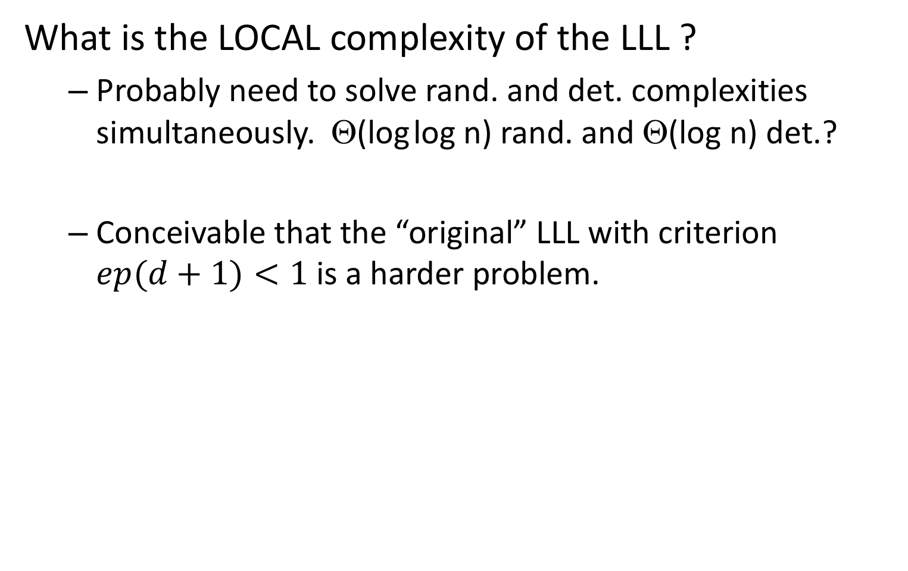
Open Question
What is the LOCAL complexity of the LLL ?
  Probably need to solve rand. and det. complexities simultaneously. Θ(log log n) rand. and Θ(log n) det.?
  Conceivable that the “original” LLL with criterion $ep(d+1)<1$is a harder problem.

Slide 46
Thank you!

